Slide 1
Payables project

Slide 2
Project objective :
To enable the user to manage vendor invoices, payments, reconciliation from Cash management module, period closing activities in the Accounts Payable module and post the payable entries from General Ledger Module.
Project outlines :
step1.Create and Manage Supplier Invoices:
Create Distribution set, payment term and withholding Tax code and Group
Create supplier.
Enter many invoice [ Standard, debit invoices] details such as supplier information, payment terms, and line items, calculate withholding Tax.
Validate and create account.
Create quick invoice.
Create Recurring invoice with special calendar.
Show all accounting entries for each invoice.

Slide 3
step2.Payment Processing .
Create Bank, branch and bank account.
Payment Batches:
Create payments for your created invoices.
Show all accounting entries for each payment .
Handle Prepayments and Advances:
Create prepayment invoices cycle prepayments and advances with payment and apply.
Show all accounting entries for each invoice.
Void Payments:
Process voids for incorrectly issued payments.
Show all accounting entries for each invoice.

Slide 4
step3.Reconcile the payments from Cash Management Module.
Reconcile the payments from Cash Management Module.
Perform the Reconcile the payments from Cash Management Module.
Create account for the payments after reconcile the payments from Cash Management Module.
step4.Period-End Closing and Reporting
AP Period-End Close:
Perform the AP period-end closing process requests and reports.
Accounts reconciled with the General Ledger.

Slide 5
Extra tasks related to GL:
1- Create journal entries, post and reverse journals with two way .
2-Create Auto copy batch.
3-Create Recurring Journals.
4-Define daily rates and create journals with foreign currency.

Slide 6
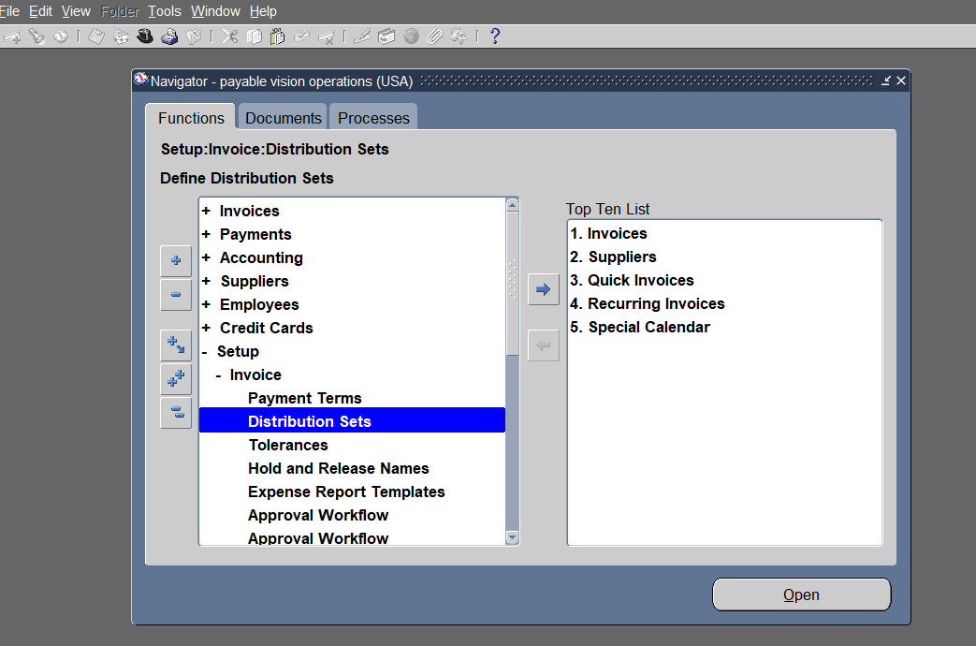
Project review:
1.1 create a distribution set
Open the payables module>setup>invoice>distribution sets>open

Slide 7
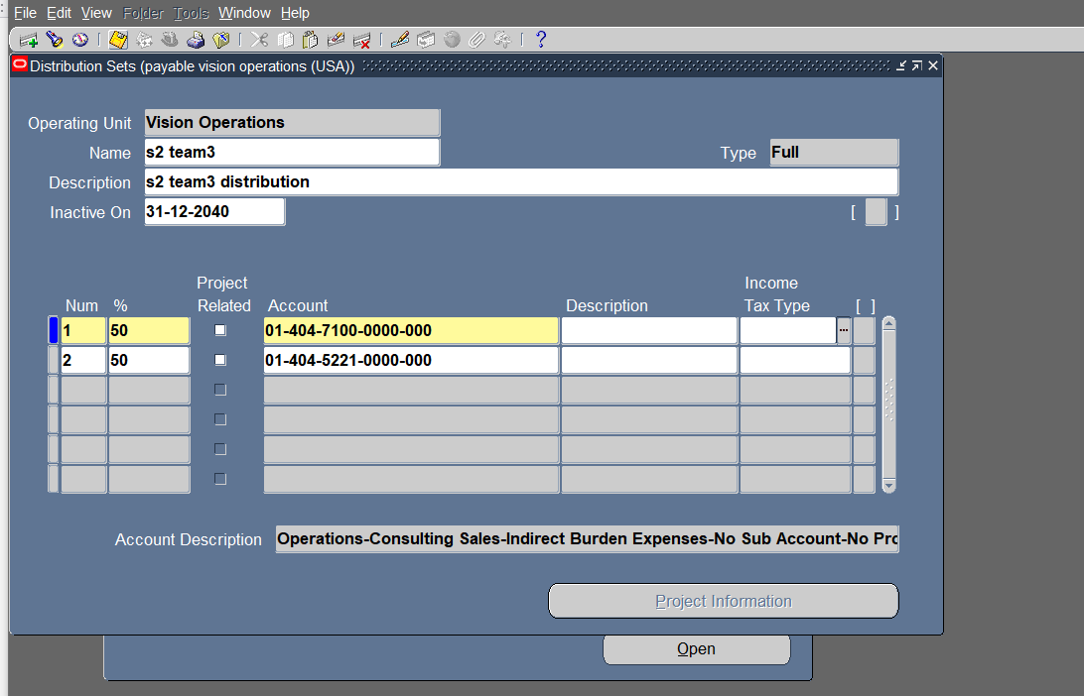
Enter values in operating unit,name,description and inactve date (coming date).
Enter values in lines number , % and add accounts according to the chart of accounts.
click save and close

Slide 8
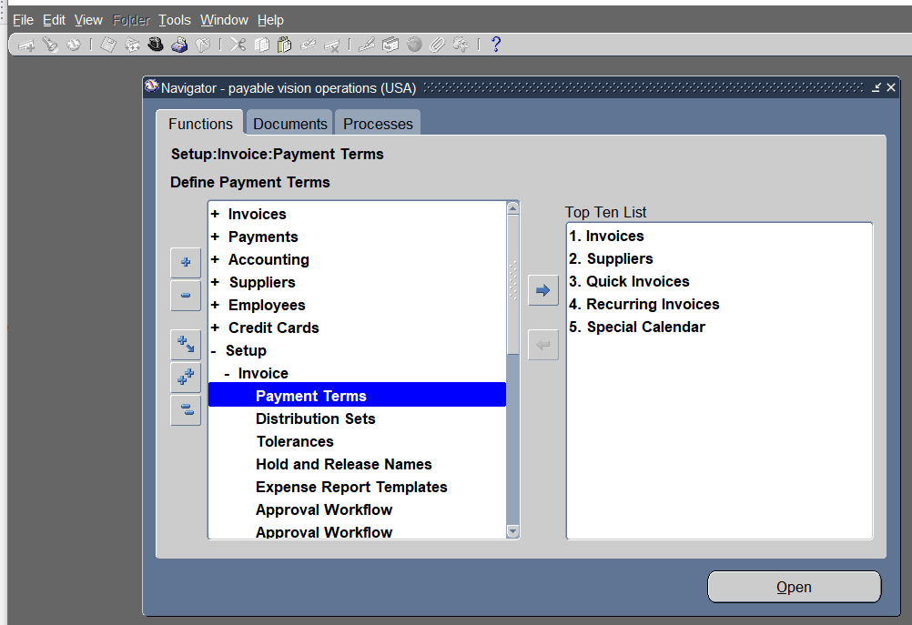
1.2 create a payment term
open the payables module>setup>invoice>payment term>open

Slide 9
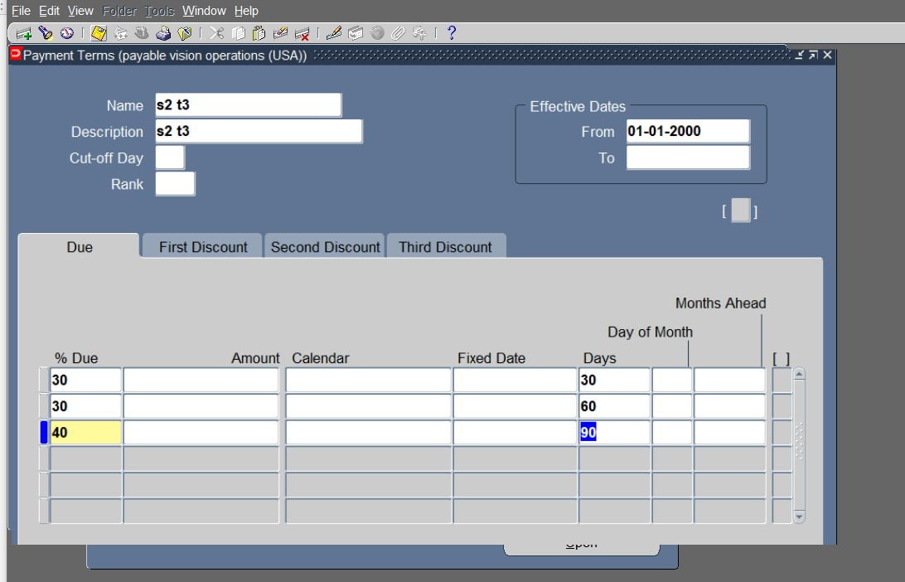
Enter values in name,description and effictive date from previous date.
Enter values in lines % due and number of days
click save and close

Slide 10
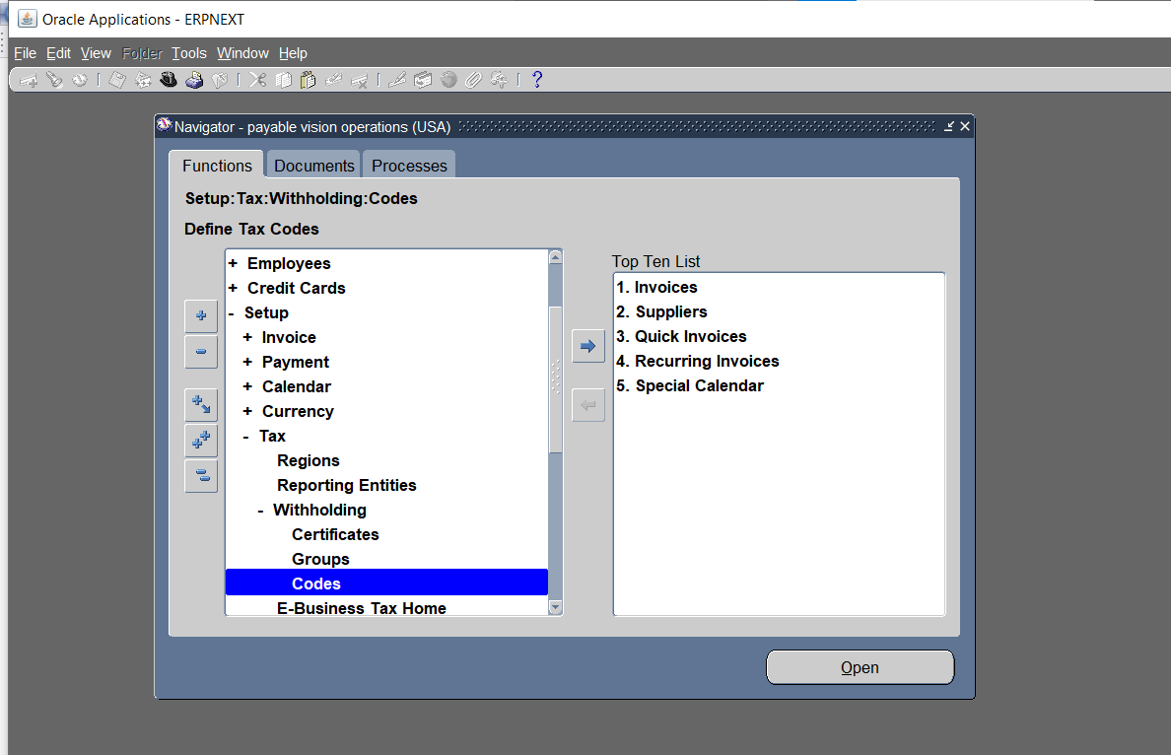
1.3 Create tax code
open the payables module>setup>tax>codes>withholding>codes>open

Slide 11
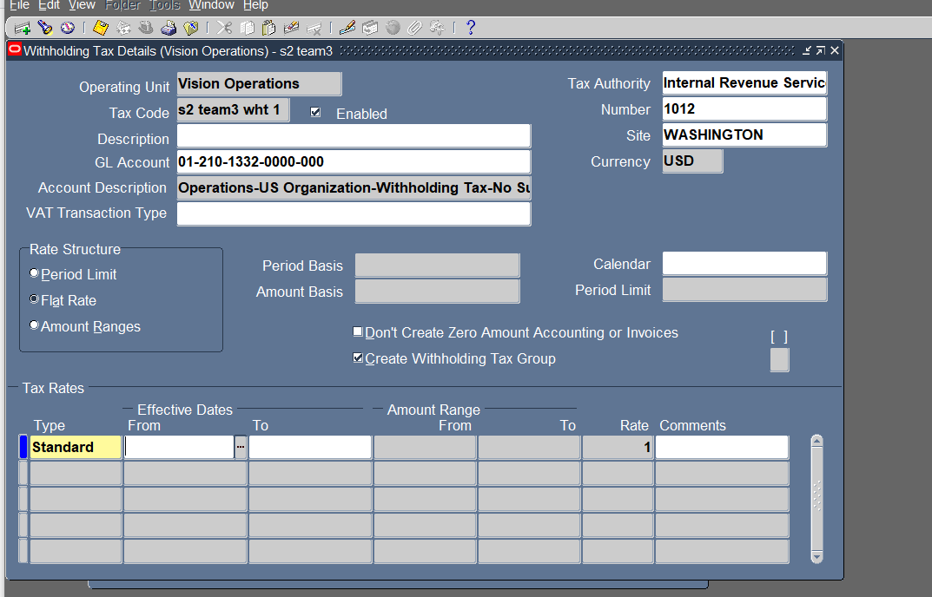
Enter values in operating unit and tax code
Enter values in tax authority,number and site
Enter general ledger account according to the chart of accounts
Choose type standard and enter rate
Click save and close

Slide 12
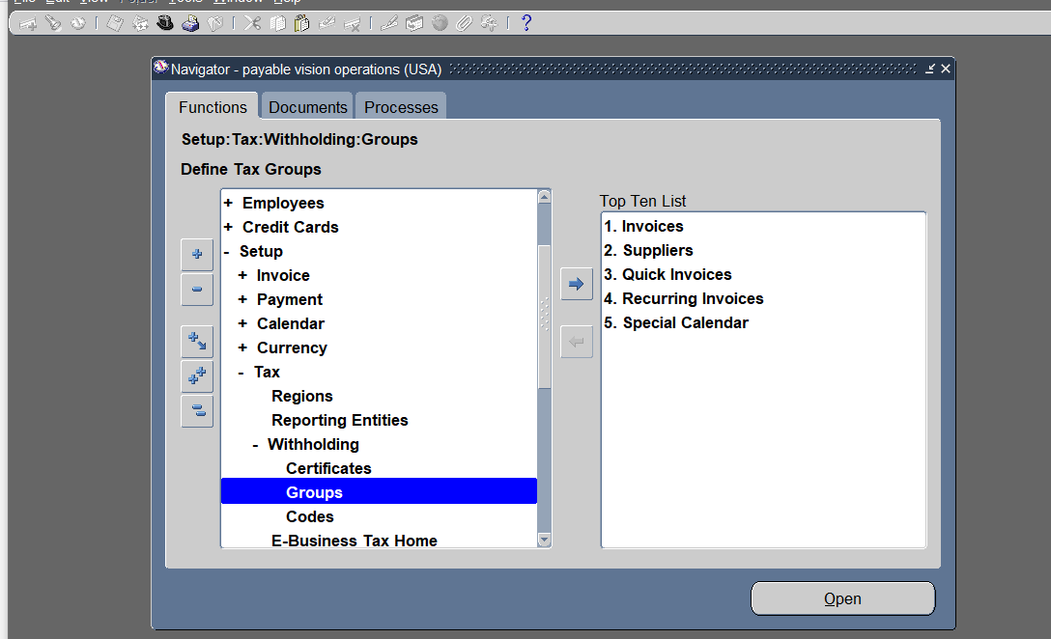
1.4 Create tax group
open the payables module>setup>tax>codes>withholding>groups>open

Slide 13
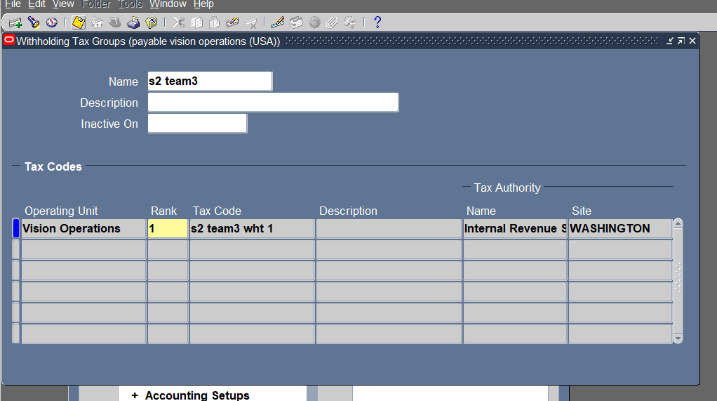
Enter values in name
Enter values in operating unit , rank and previously- created tax code.
Click save and close

Slide 14
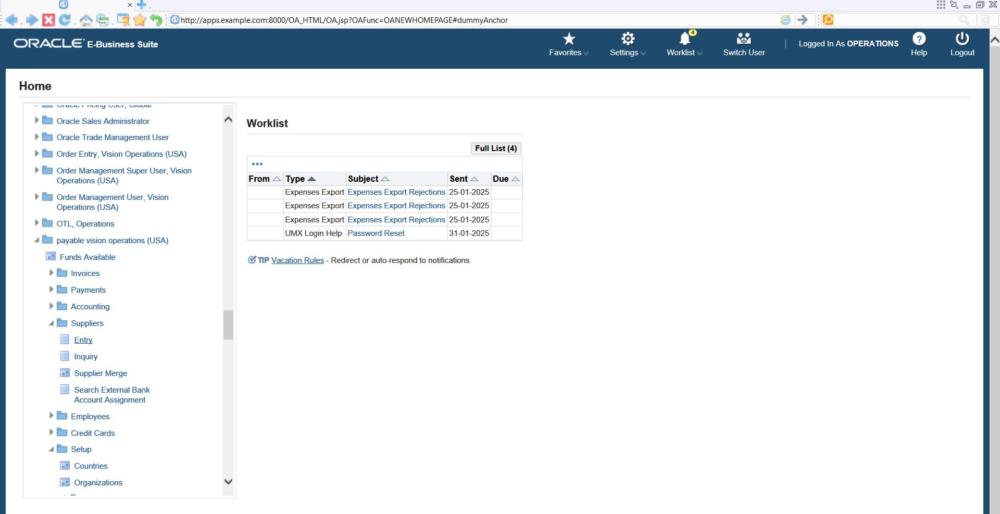
1.5 create supplier
open the payables module>supplier>entry

Slide 15
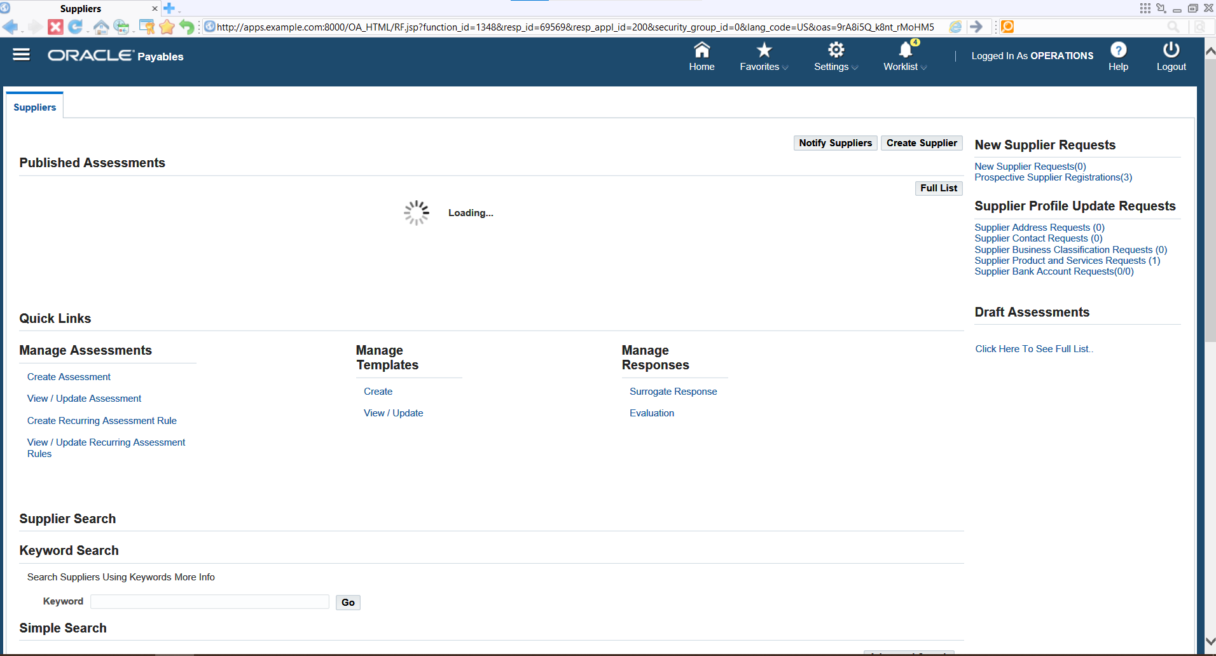
Click on create supplier

Slide 16
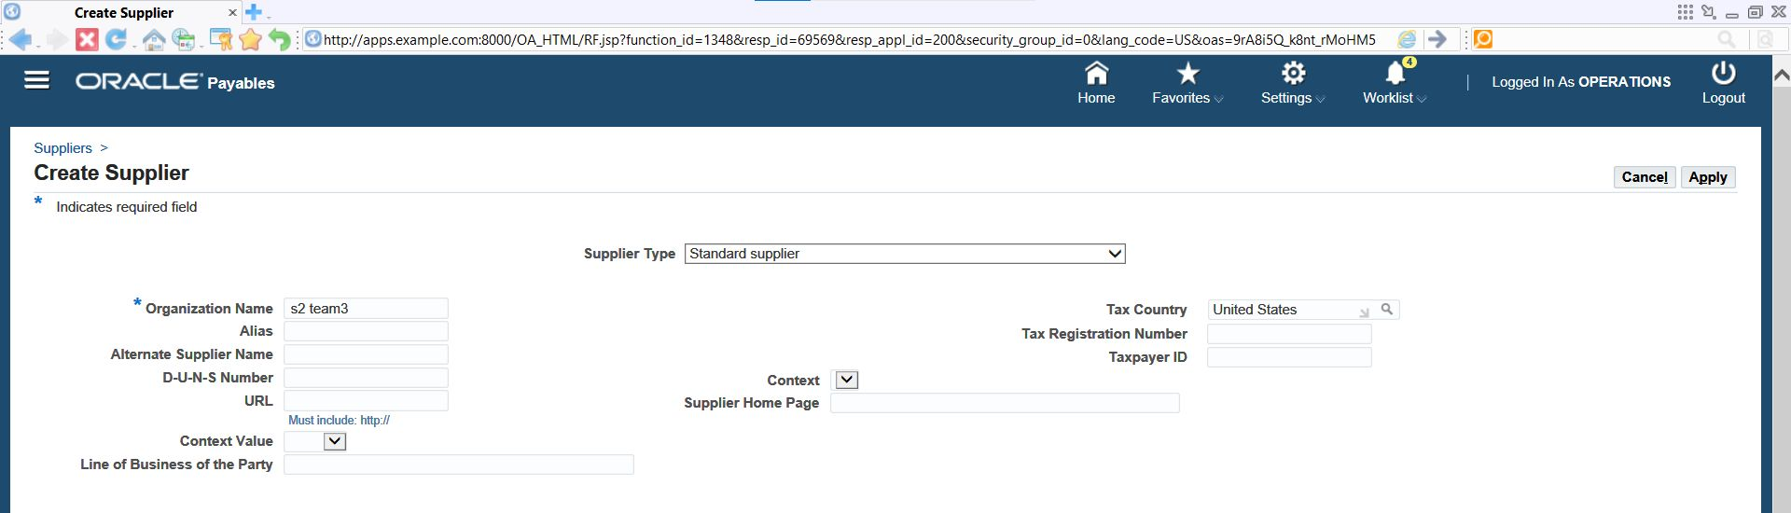
Choose supplier type>Enter values in name>choose country>click apply

Slide 17
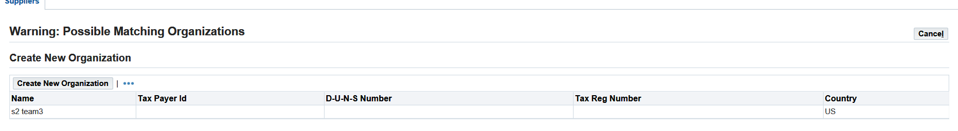
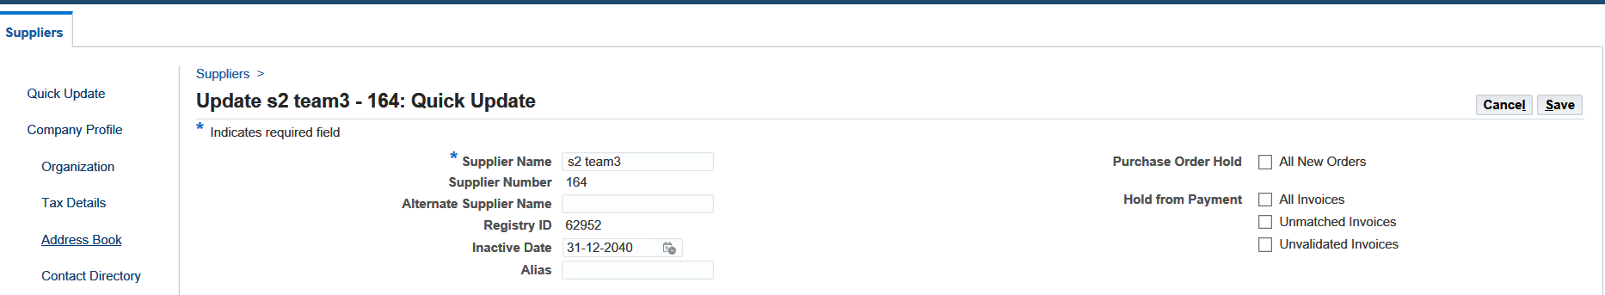
Click on create new organization
Enter inactive date (a coming date) >save

Slide 18
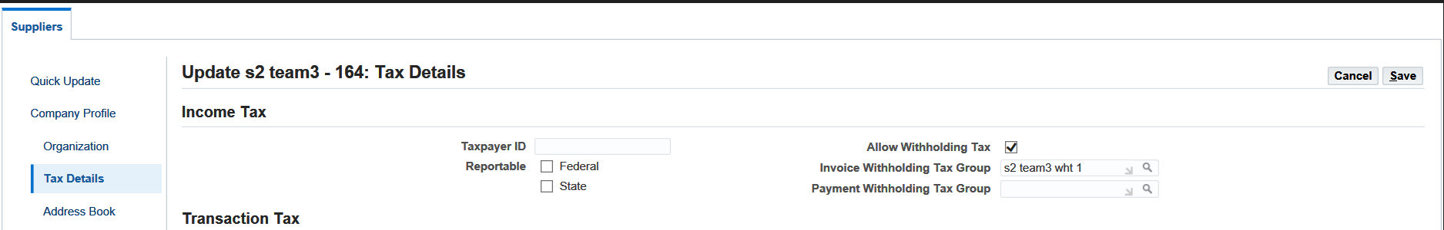
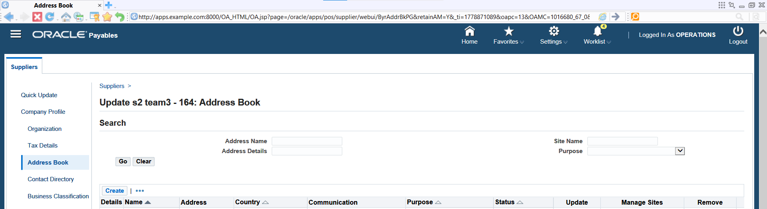
Click on tax details > mark allow withholding tax > enter created withholding tax group > save
Click on address book>create​

Slide 19
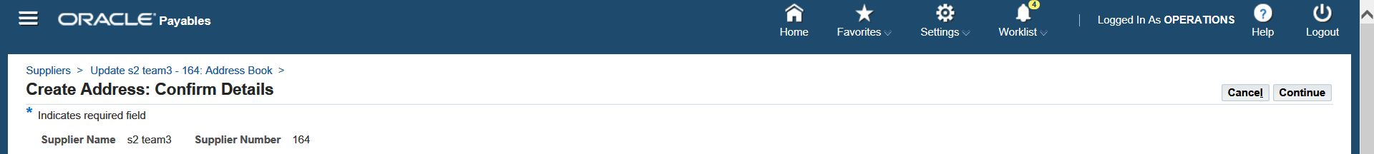
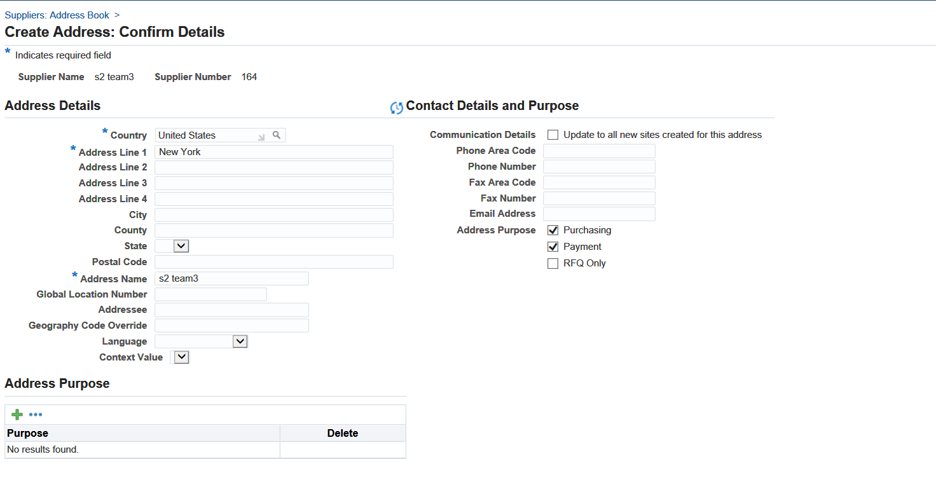
Choose country >enter address line 1> enter address name > choose "purchasing" and "payment" > continue

Slide 20
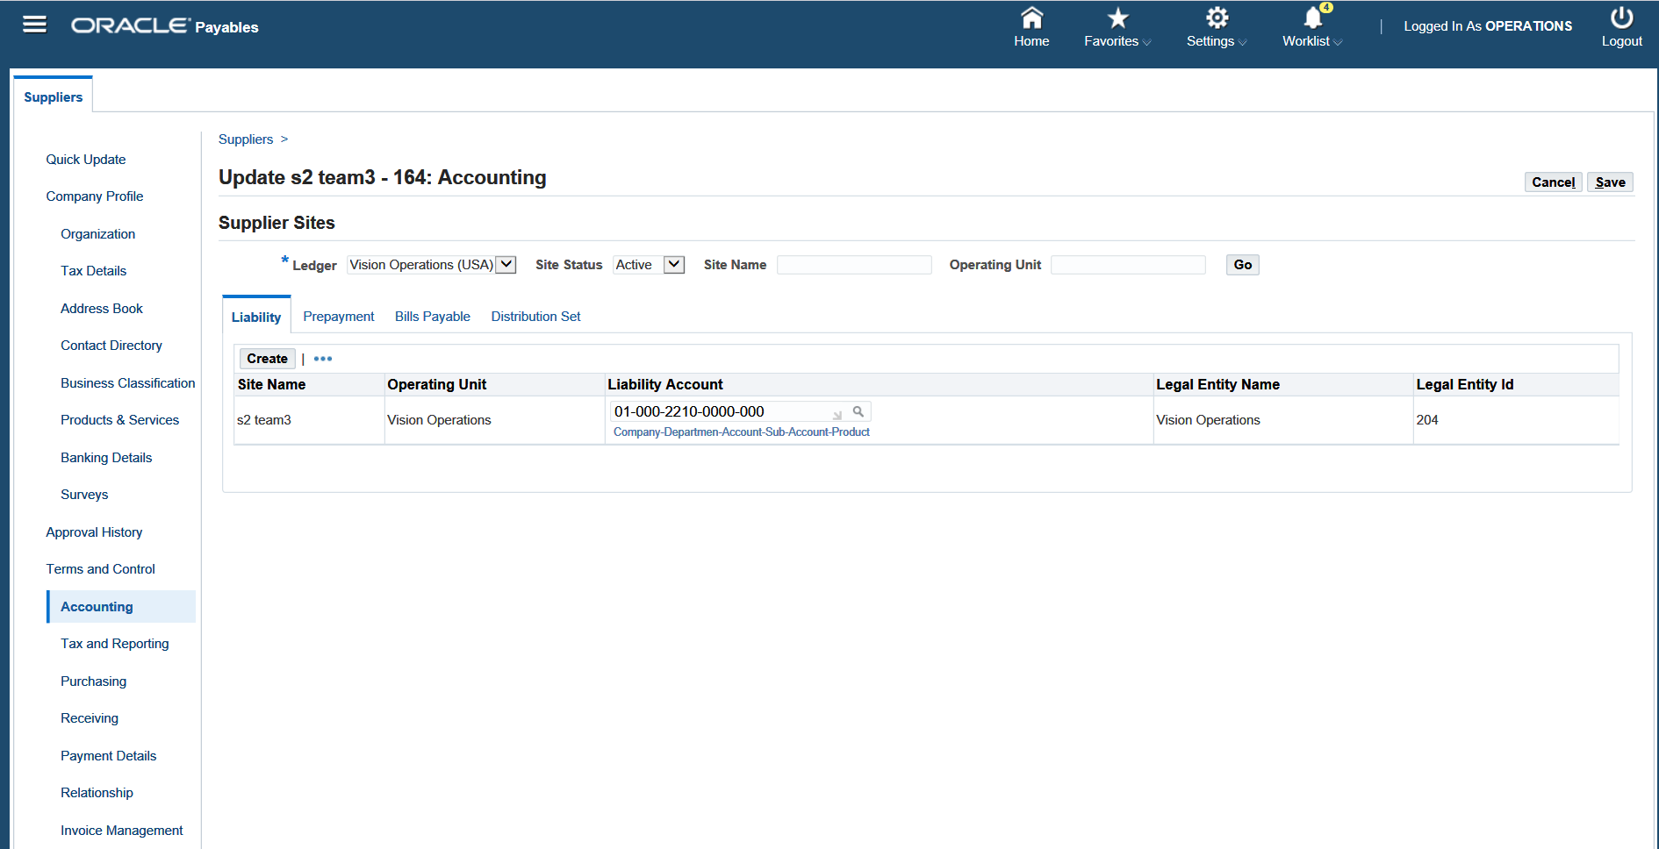
Click on accounting > click on liability > create > enter the liability account

Slide 21
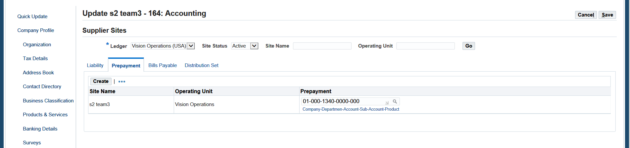
Click on prepayment>create > enter the prepayment account

Slide 22
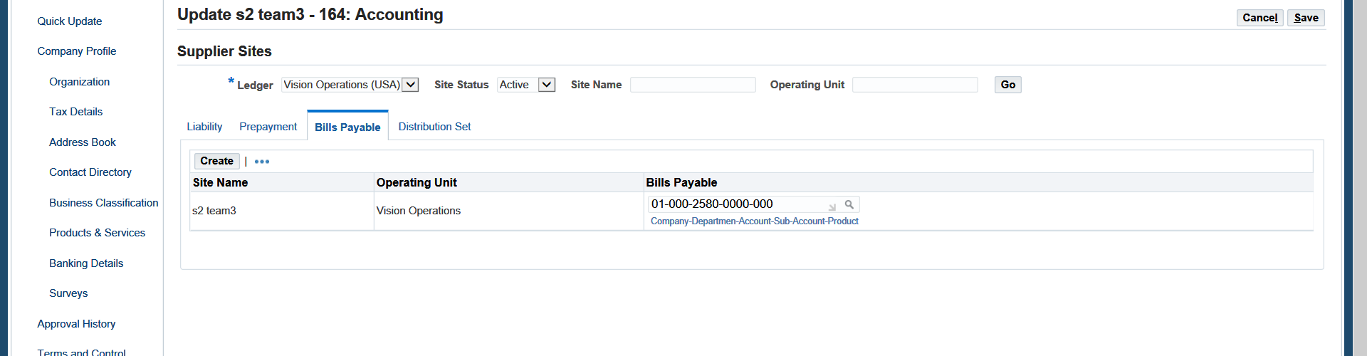
Click on bills payable>create > enter the bills payable account

Slide 23
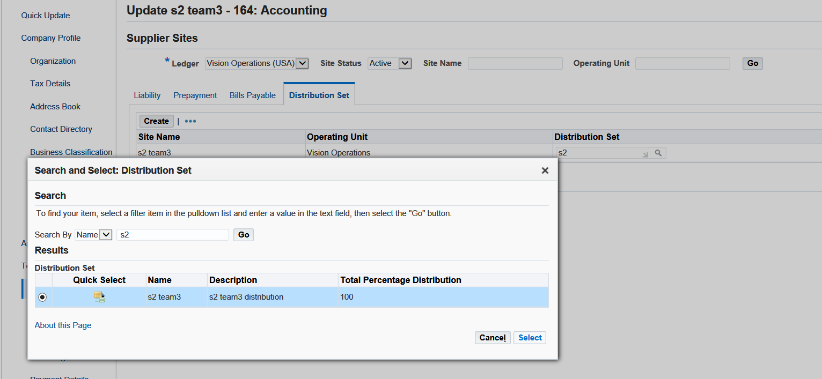
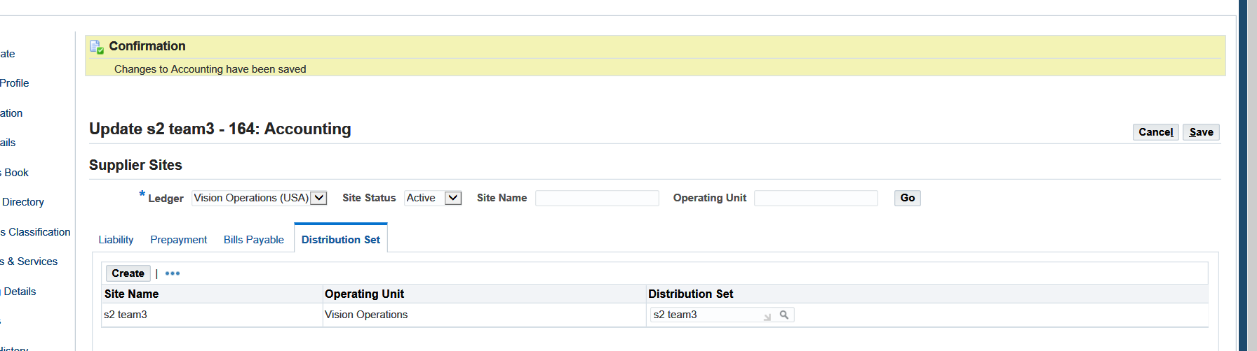
Click on distribution set > create> choose the created distribution set > save

Slide 24
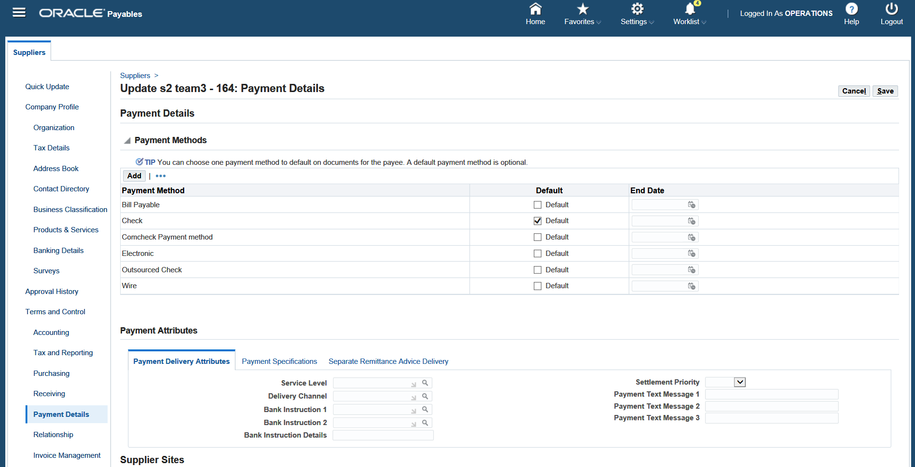
Click on payment details > select the payment method > save

Slide 25
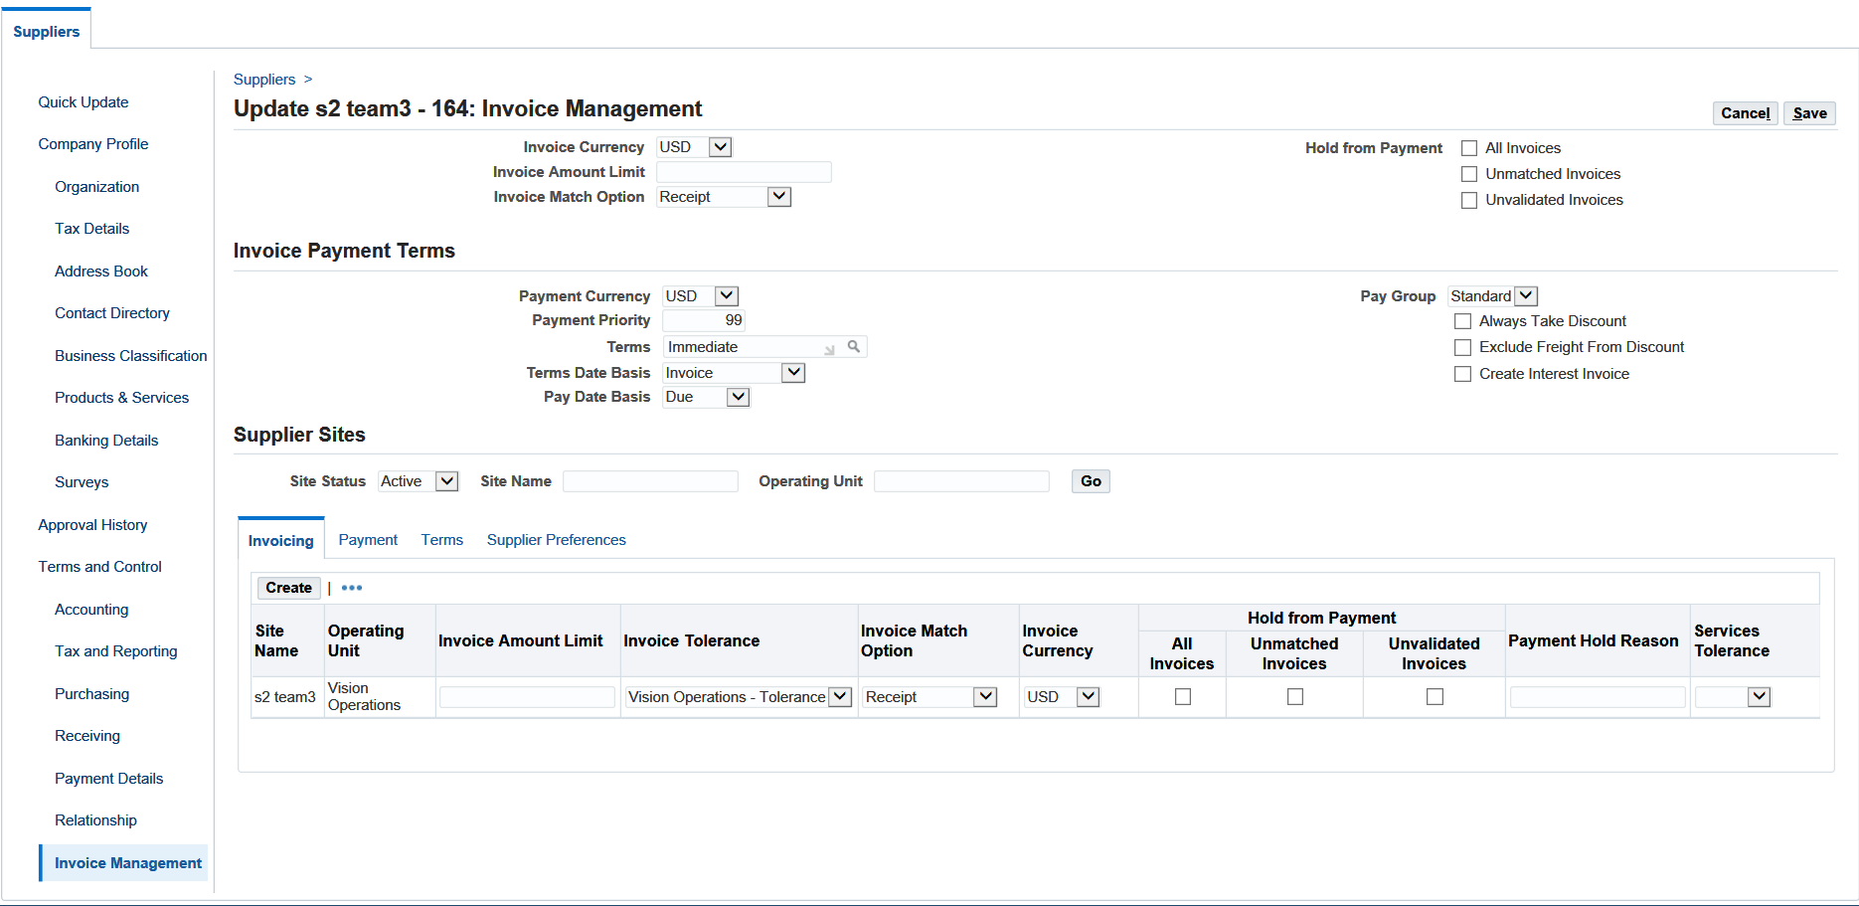
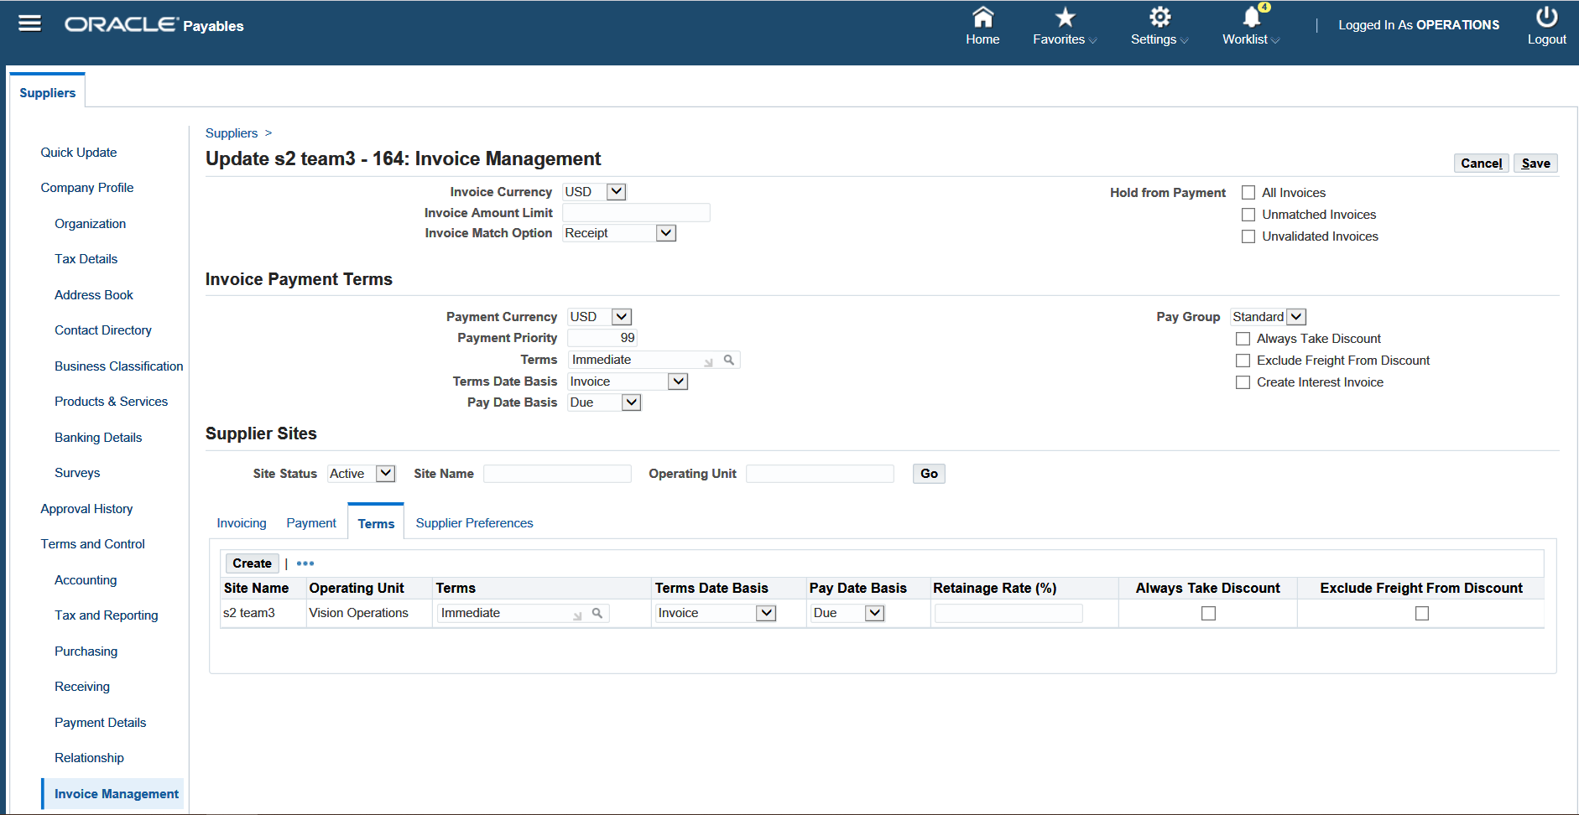
Click on invoice management > click on terms

Slide 26
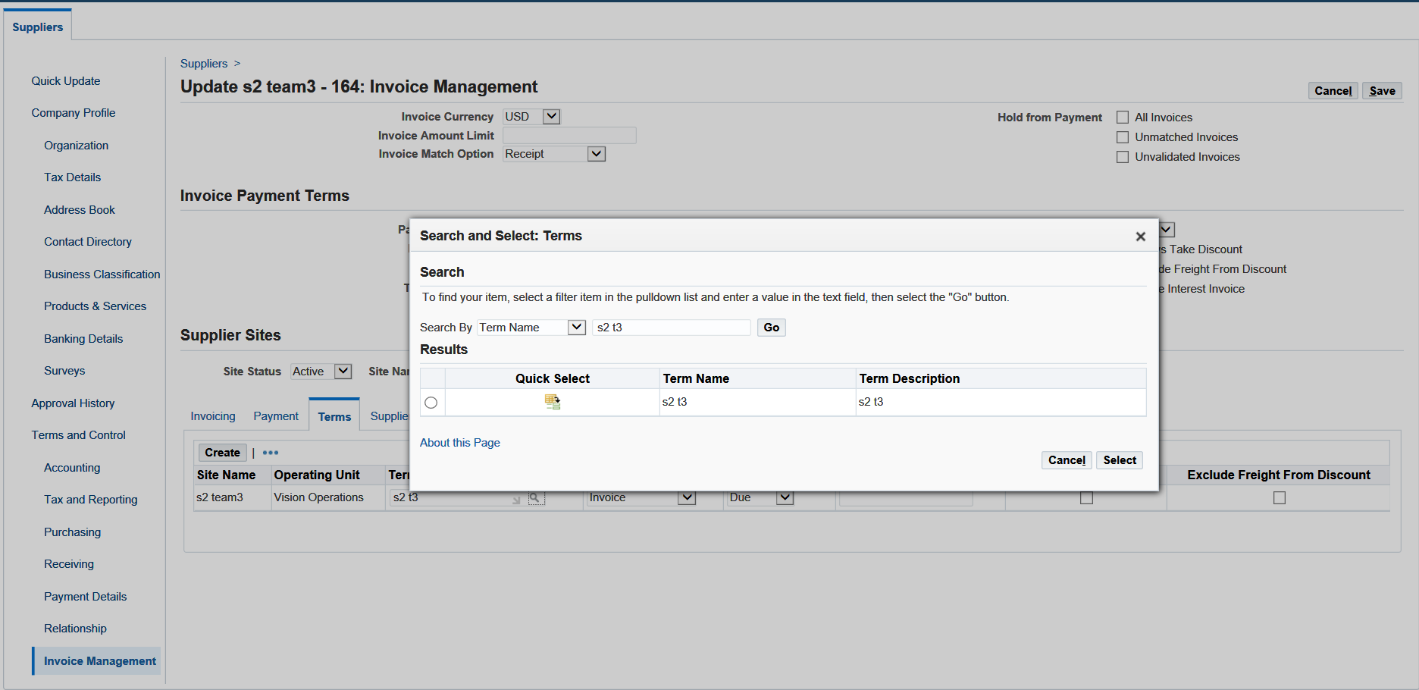
Choose the created payment term> press select

Slide 27
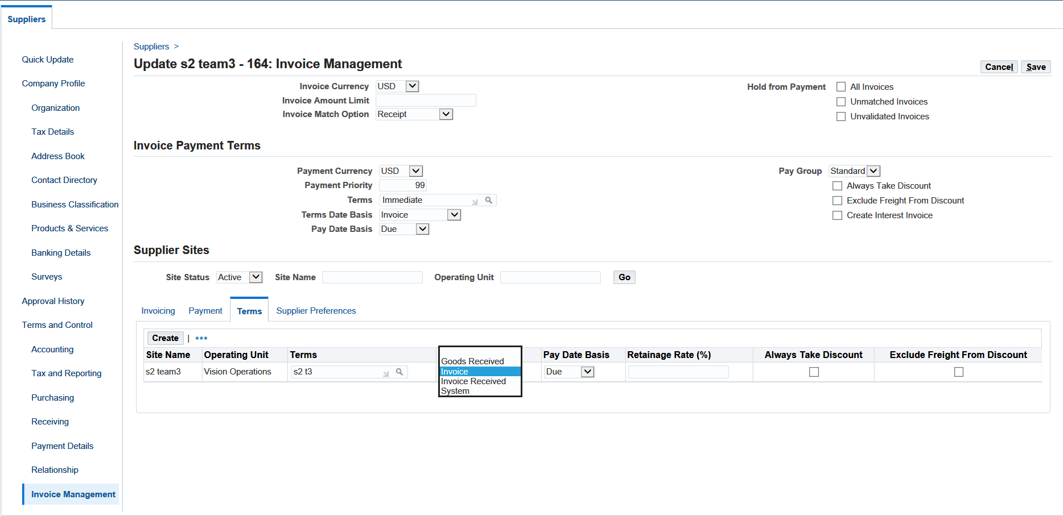
Choose the terms date basis > save

Slide 28
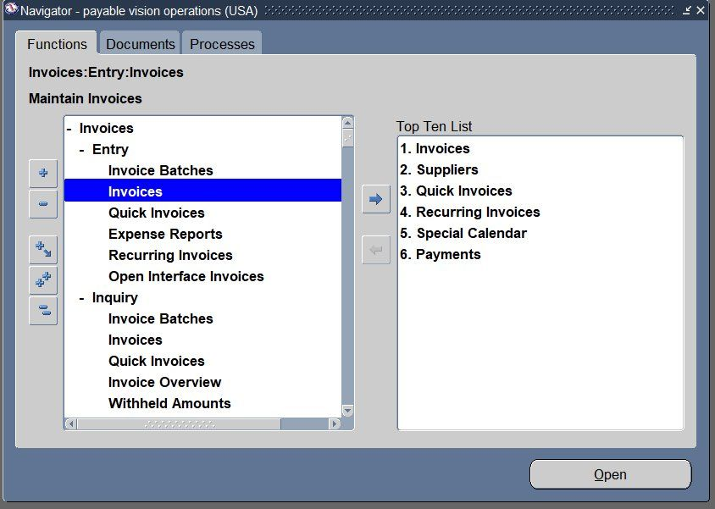
1.6 Create invoices
Standard invoice
open the payables module> invoices > entry > invoices > open

Slide 29
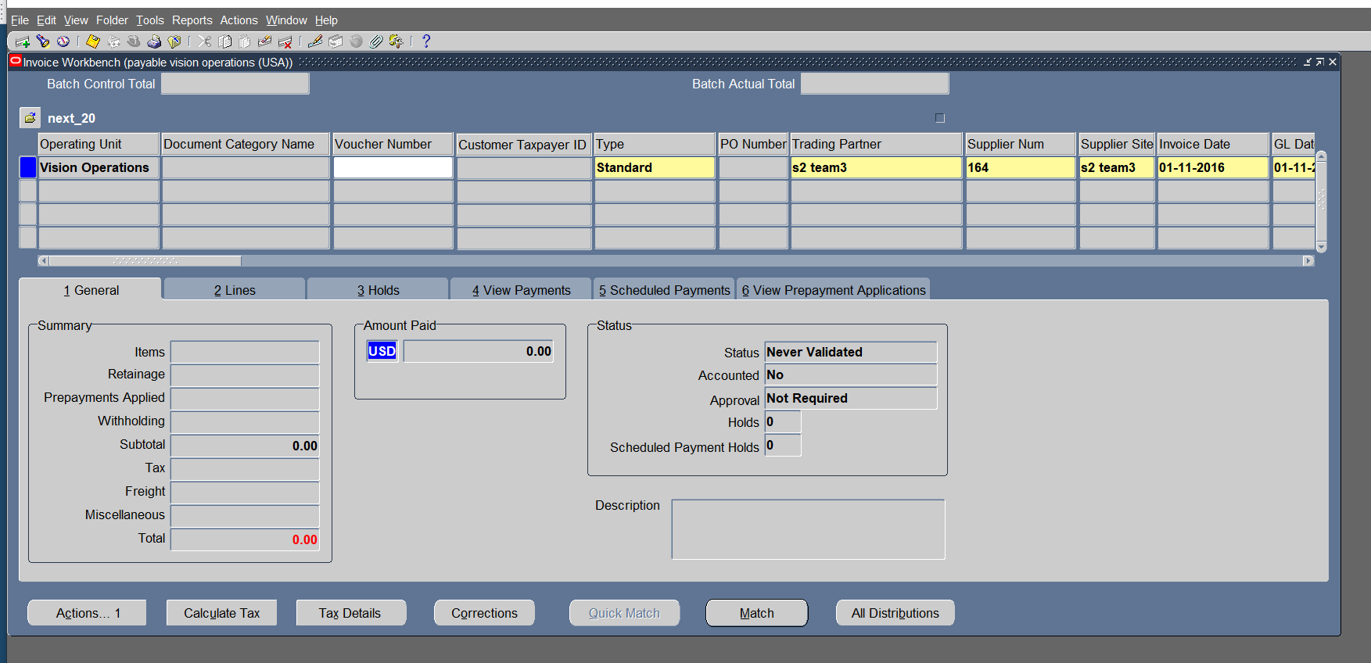
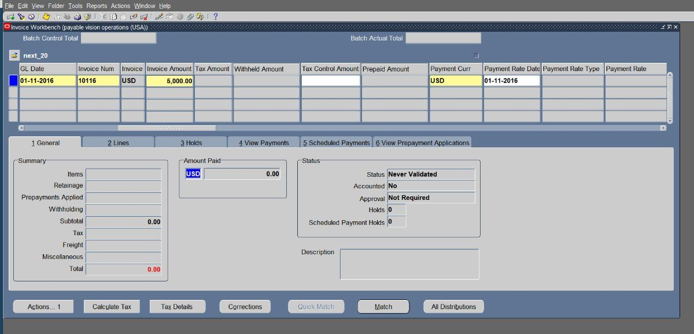
Choose the type "standard" >Enter supplier in the header > invoice date
Enter gl date > enter invoice num > enter invoice amount

Slide 30
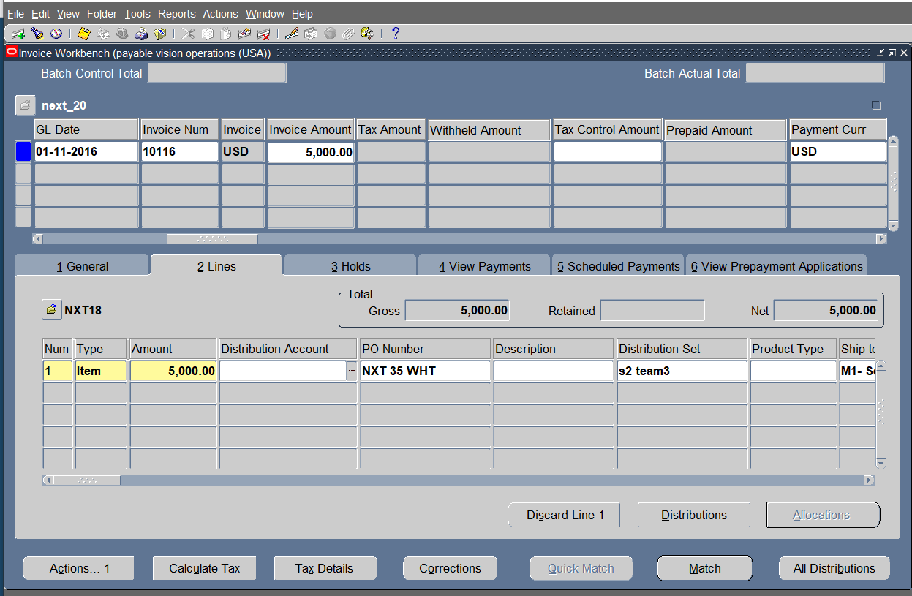
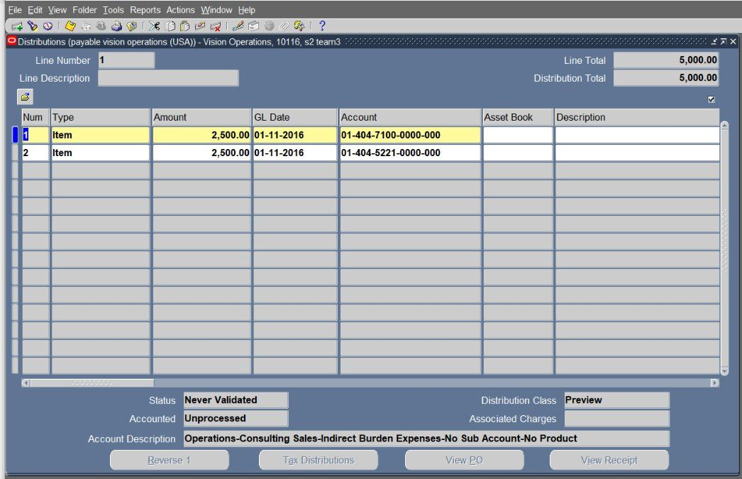
Open lines > choose item > enter amount > press all distributions to view the distribution set applied to the supplier> close the tab

Slide 31
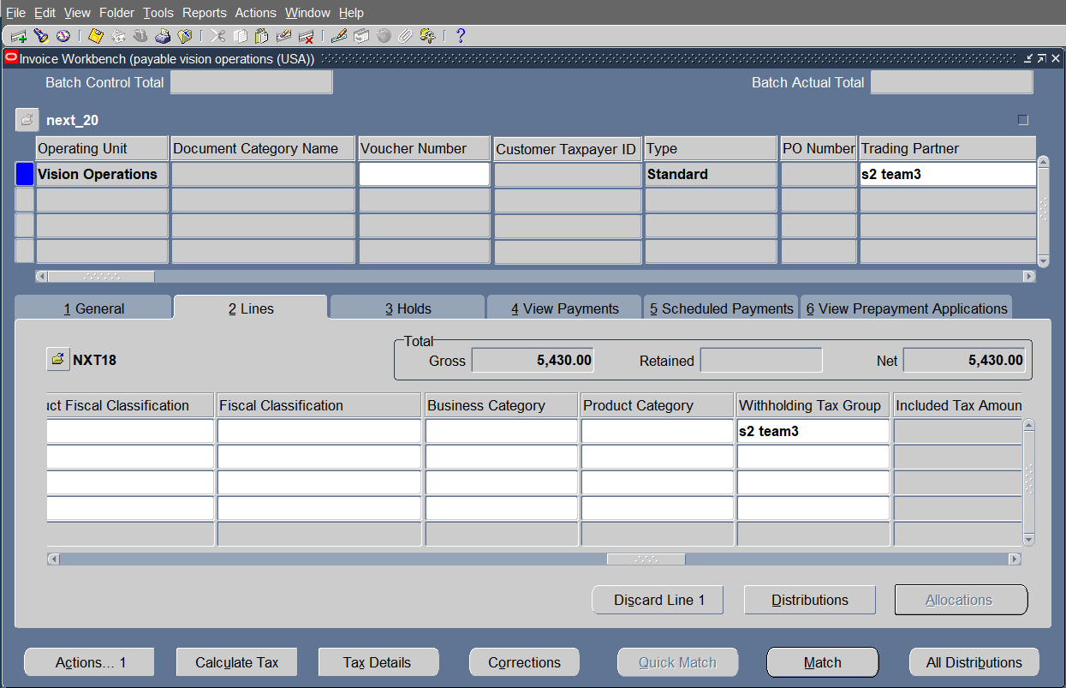
Open lines > Enter the withholding tax group name

Slide 32
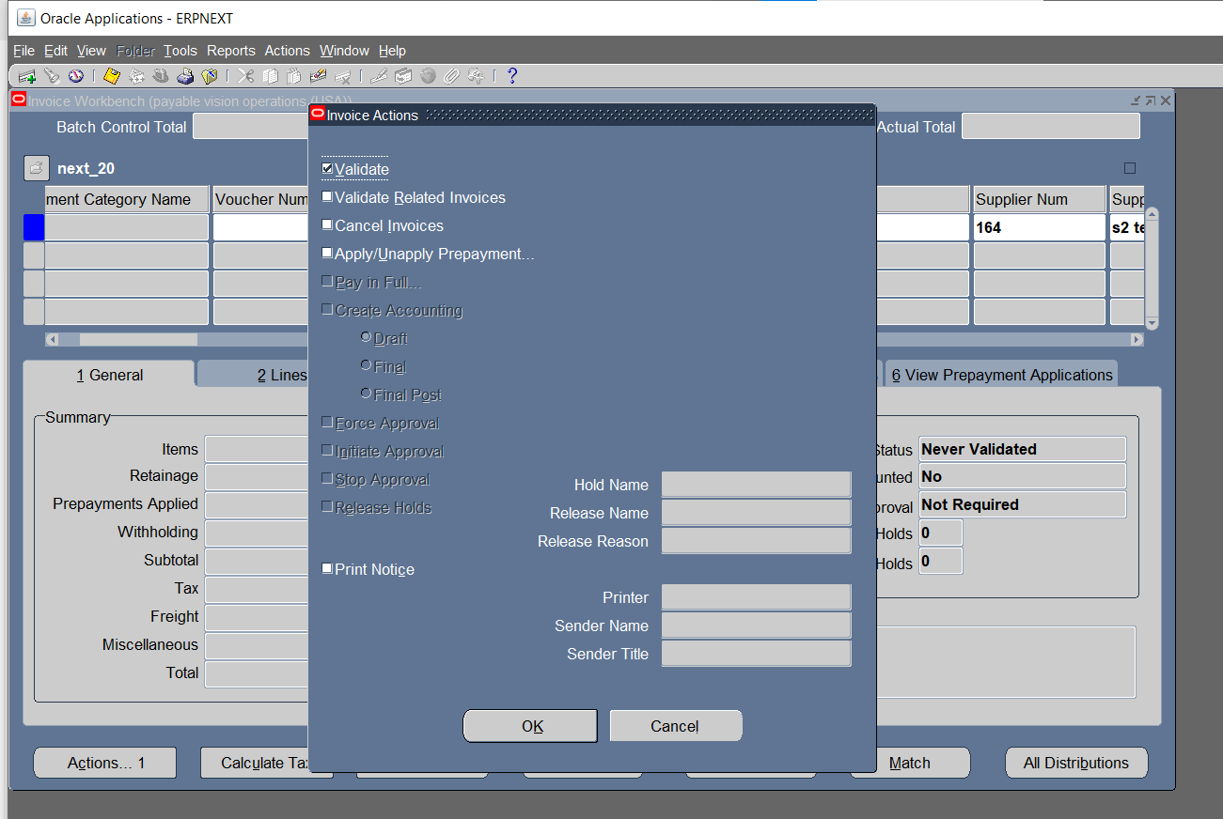
Press Actions 1 > choose validate > click ok

Slide 33
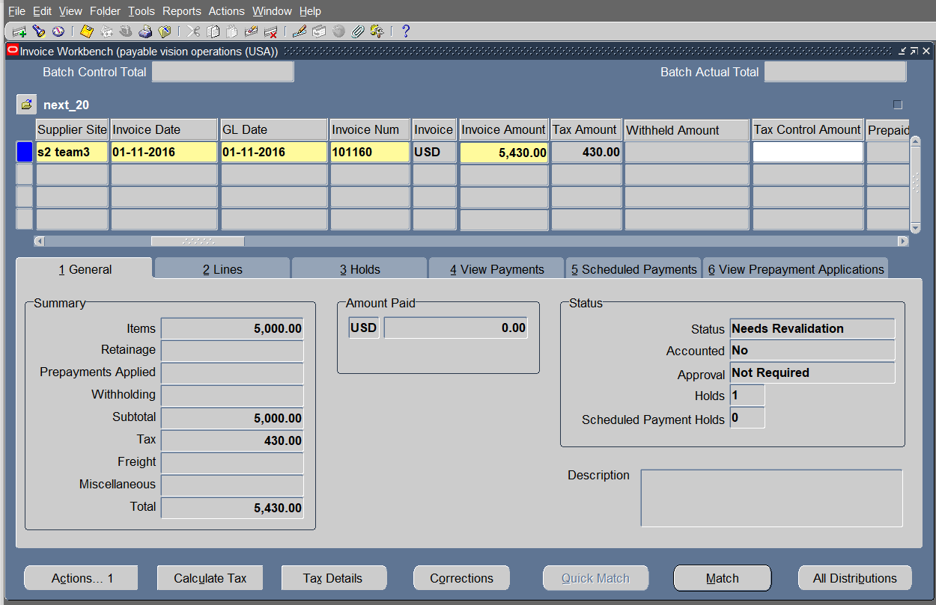
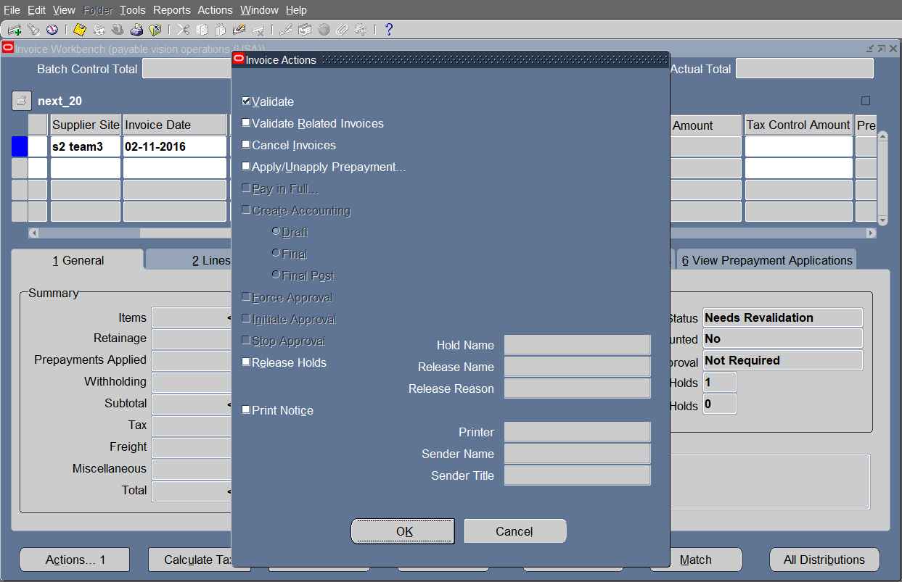
Add the tax amount to the invoice amount > revalidate

Slide 34
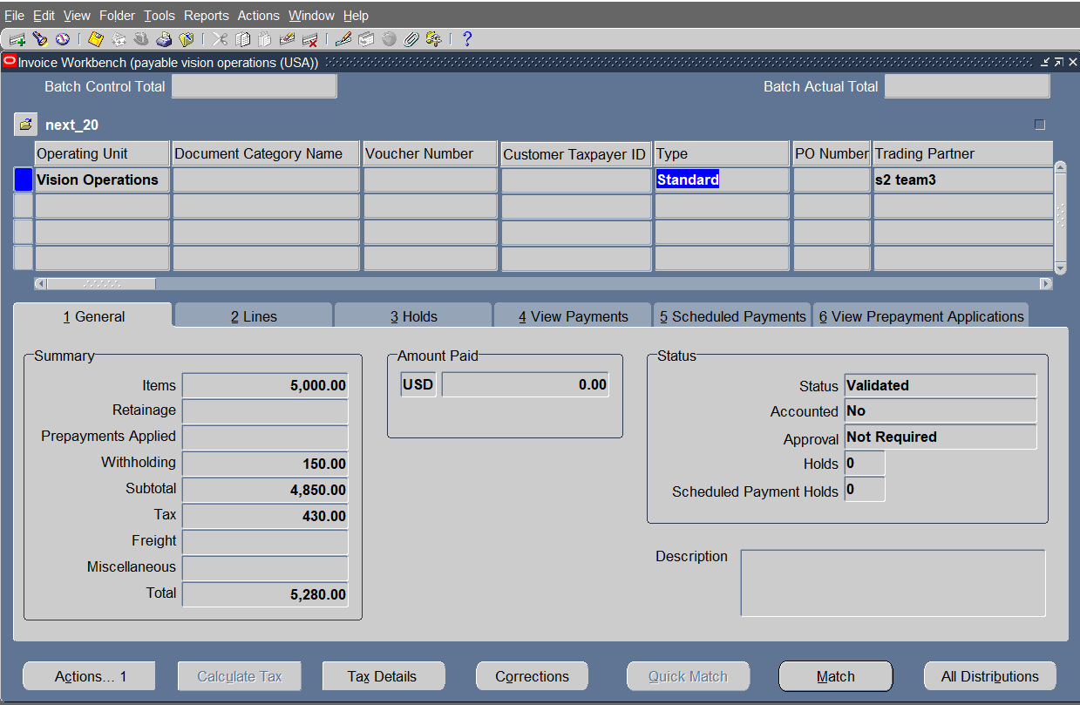
Open general > press actions1

Slide 35
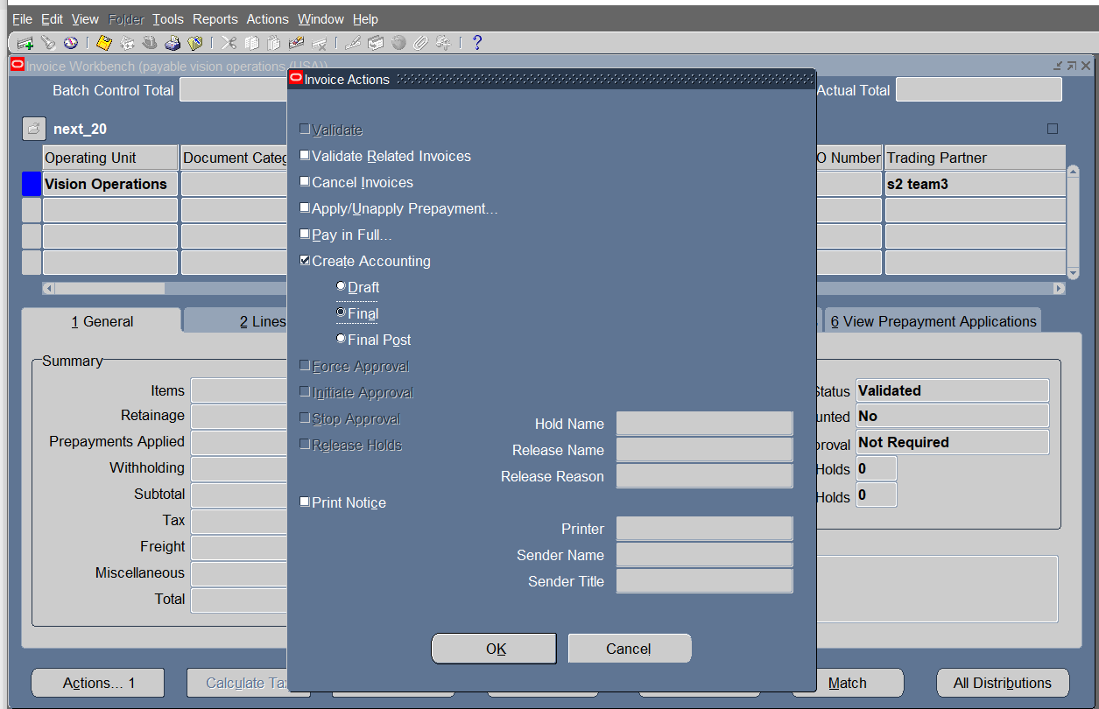
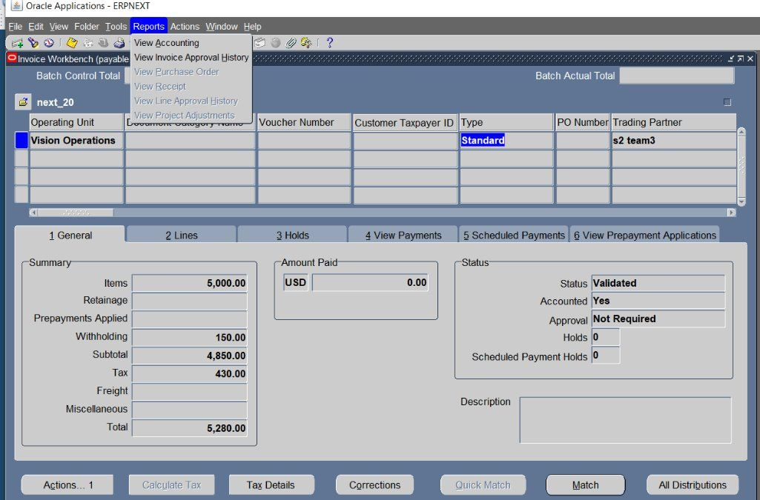
Choose accounting > final > ok
Click on Reports > choose view accounting
Note : the invoice turned into validated & became accounted

Slide 36
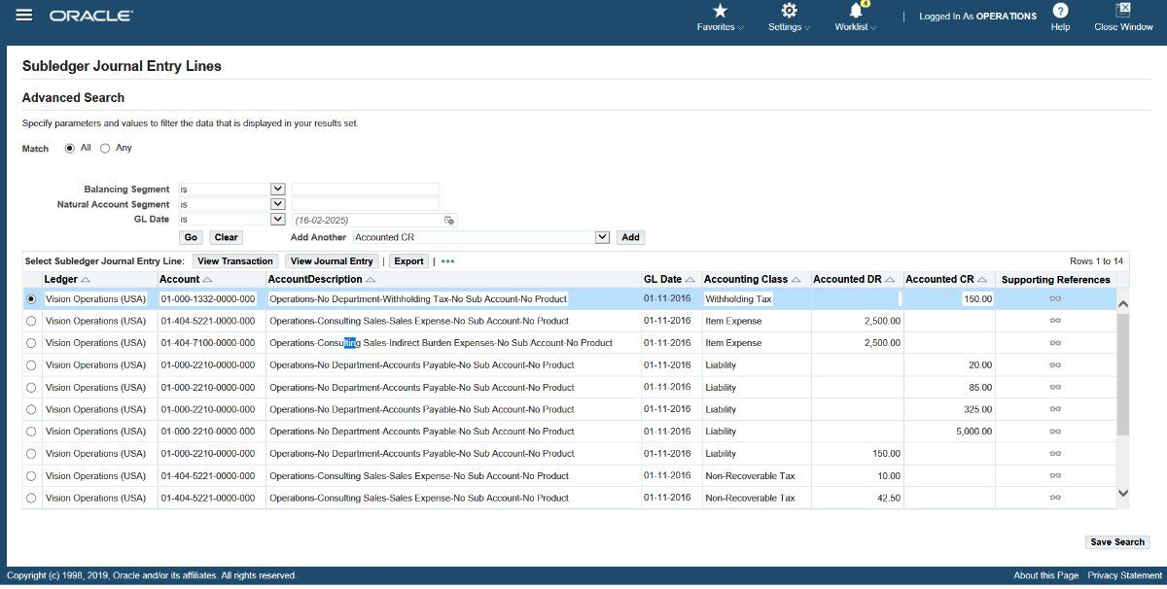
Invoice entries
dr expense ​ cr withholding tax​ cr liabilities​

Slide 37
b) debit memo
open the payables module> invoices > entry > invoices > open

Slide 38
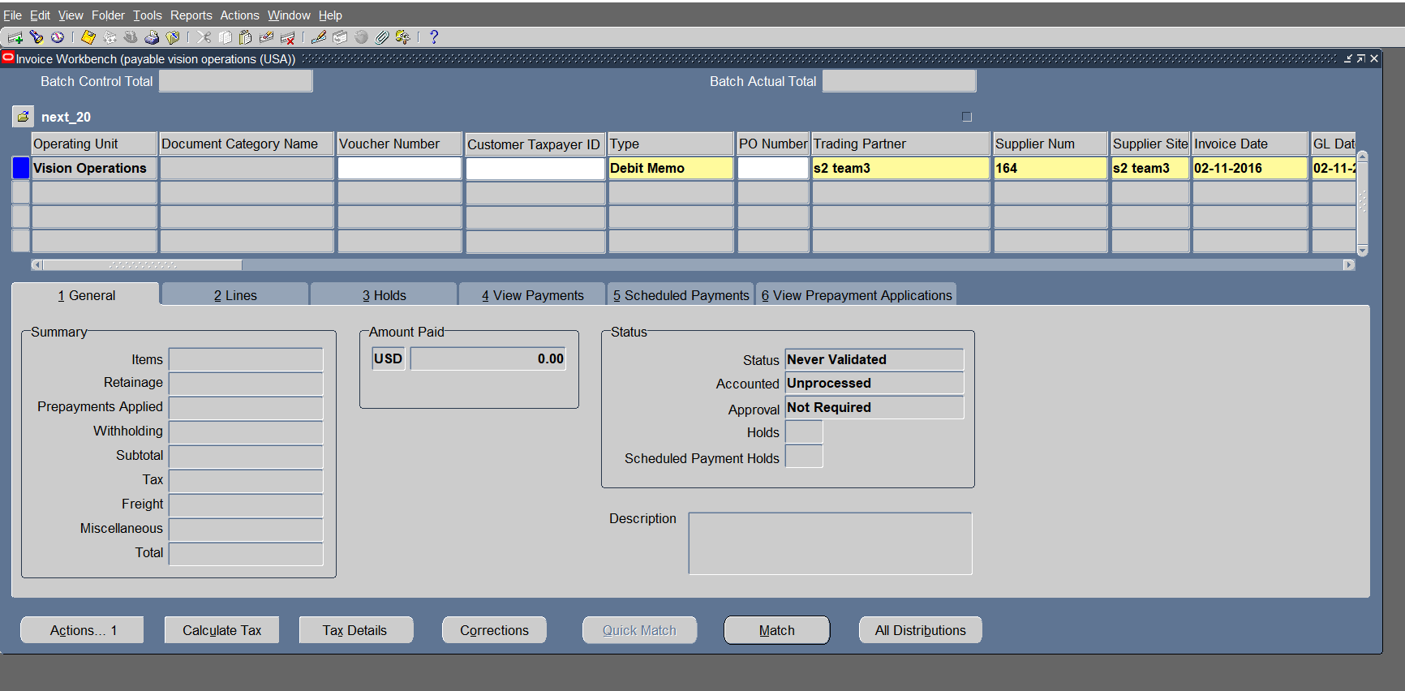
Choose the type "debit memo" >Enter supplier in the header > enter invoice date

Slide 39
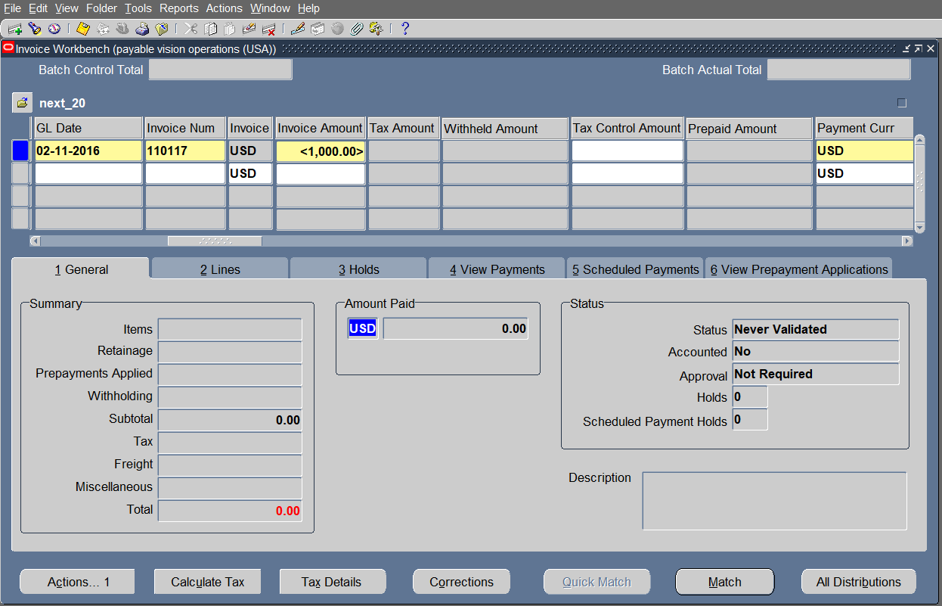
Enter gl date > enter invoice num > enter invoice amount​ by negative

Slide 40
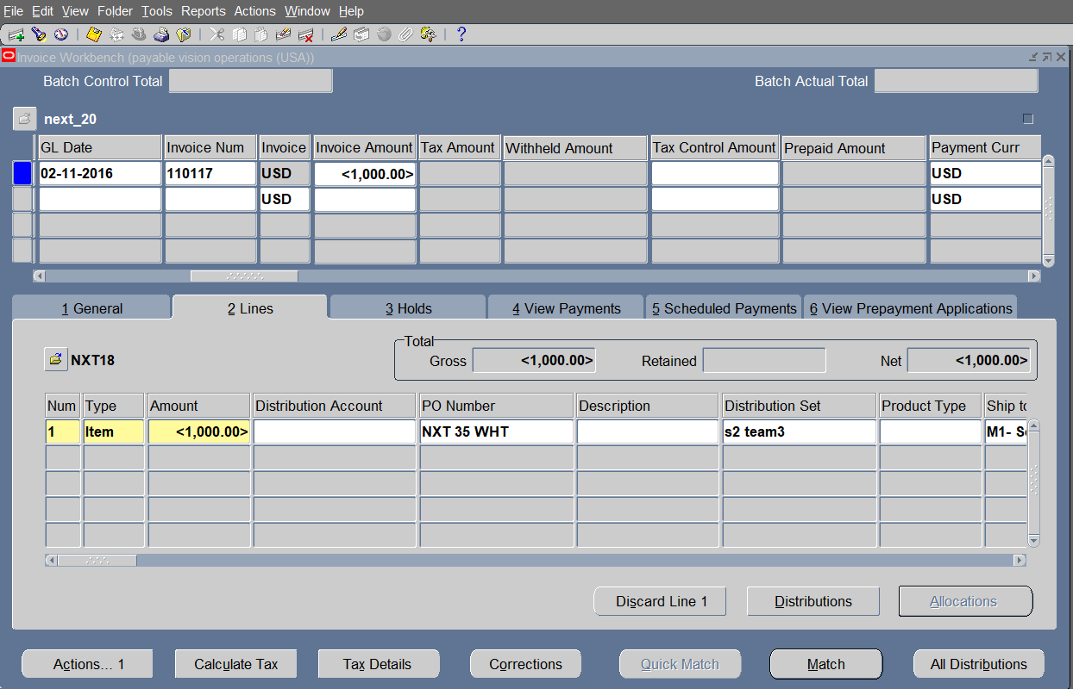
open lines > choose item > enter the amount by negative

Slide 41
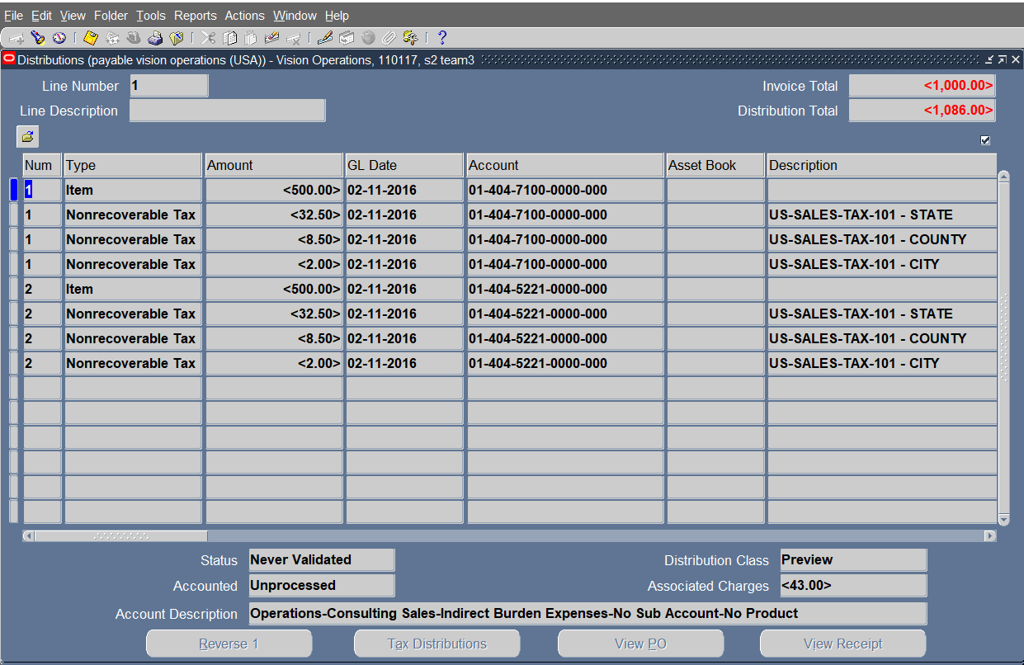
press all distributions to view the distribution set applied to the supplier​> close the tab

Slide 42
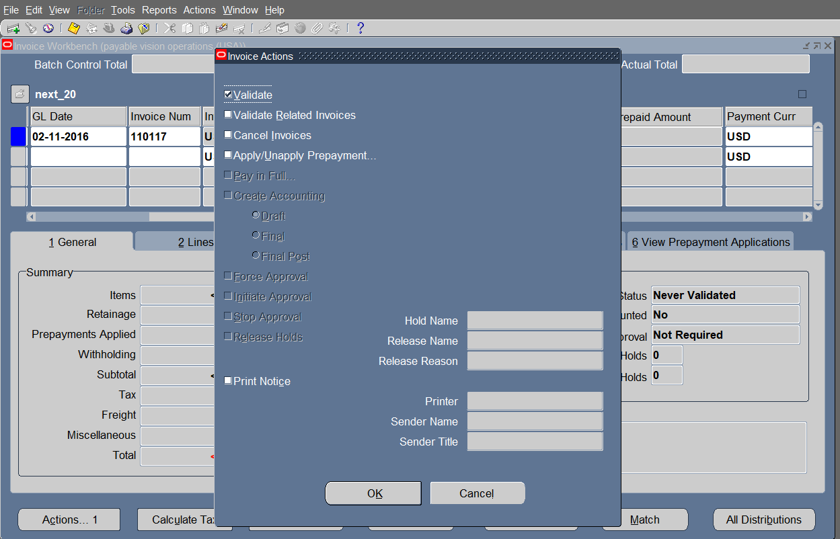
Press Actions 1 > choose validate > click ok

Slide 43
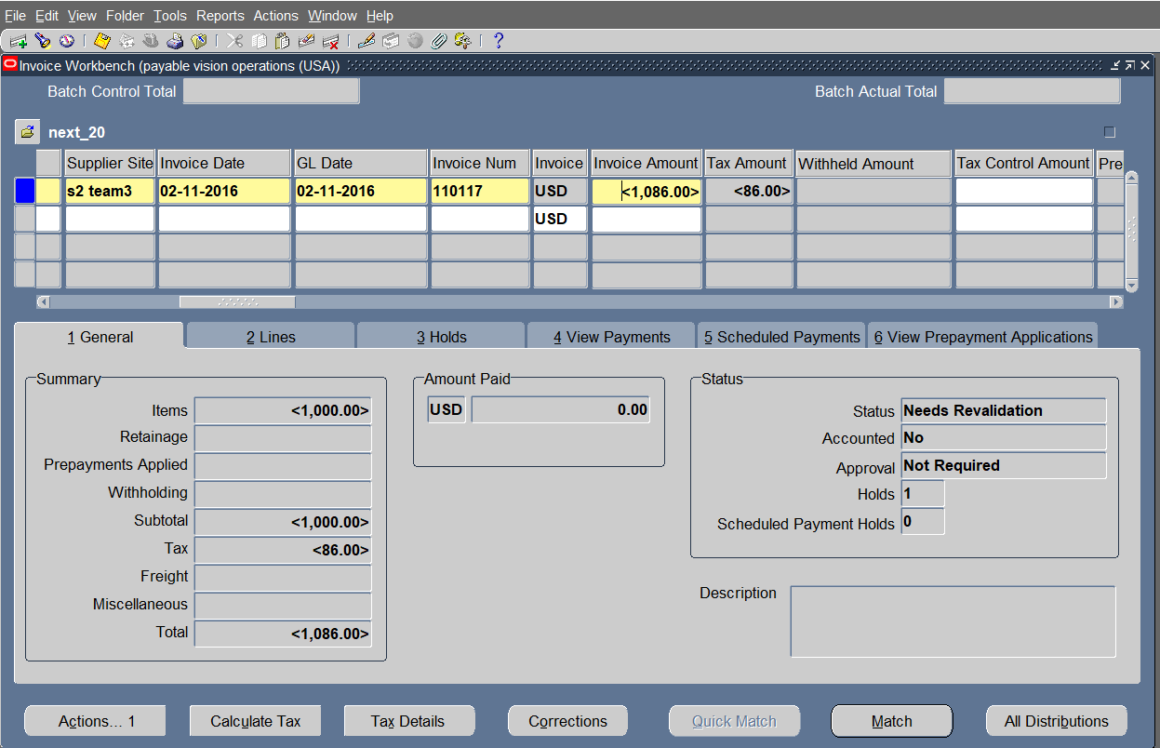
Add the tax amount to the invoice amount > revalidate

Slide 44
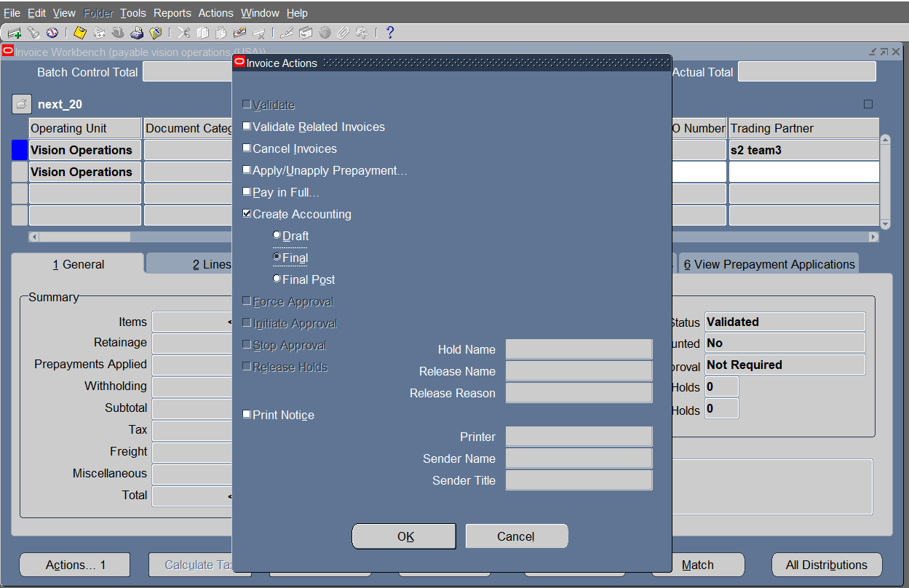
Reopen general > press actions1 > choose create accounting > final > ok

Slide 45
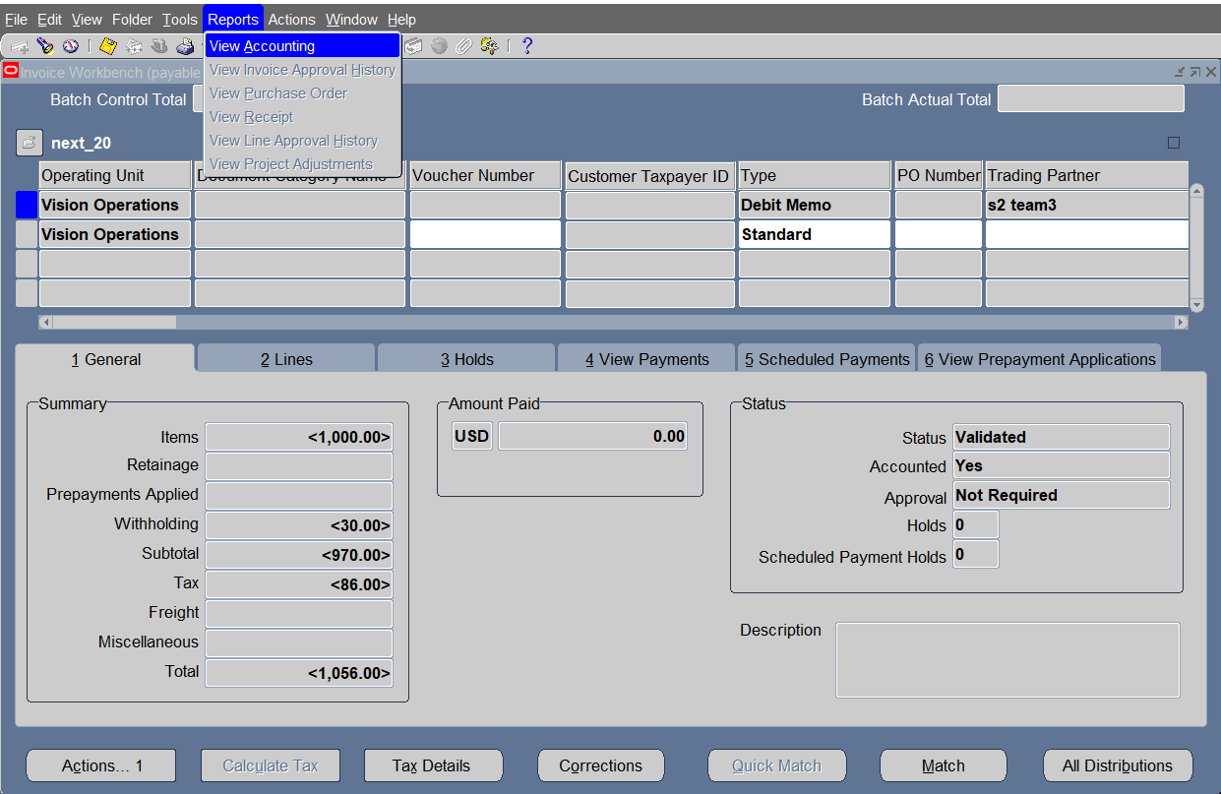
Click on Reports > choose view accounting
Note : the invoice turned into validated & became accounted

Slide 46
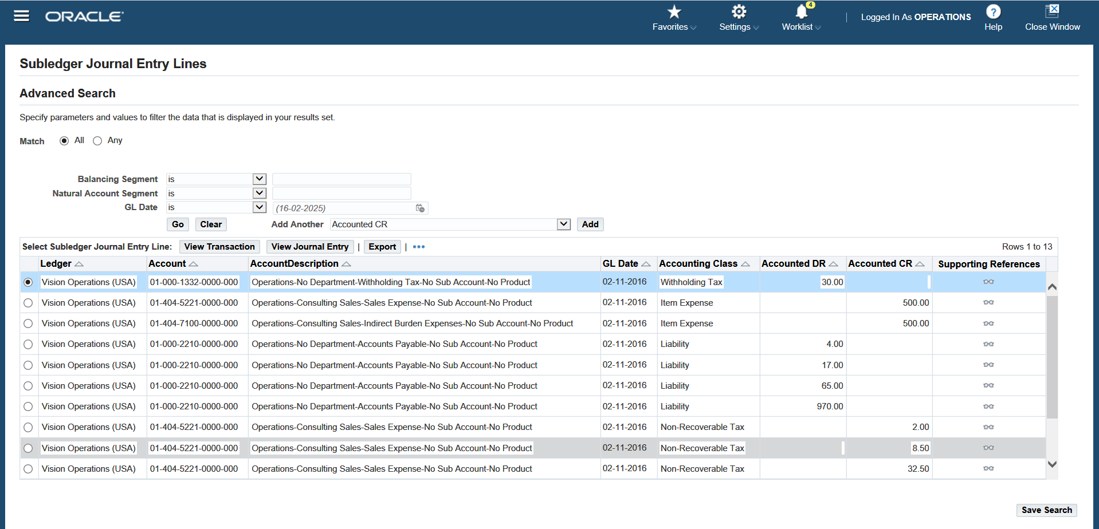
Invoice entries
​dr liabilities dr withholding tax​ ​cr expense

Slide 47
c) mixed invoice
open the payables module> invoices > entry > invoices > open

Slide 48
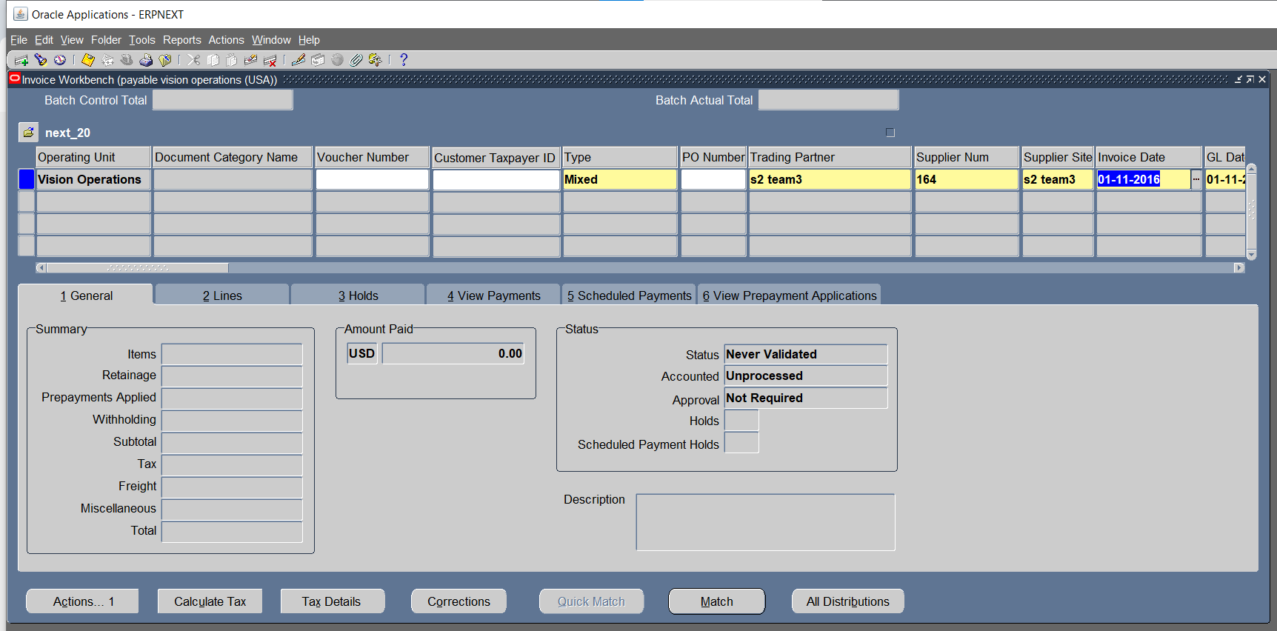


Choose the type "mixed" >Enter supplier in the header > invoice date
Enter gl date > enter invoice num > enter invoice amount

Slide 49

Open lines > choose item > enter amount > press all distributions to view the distribution set applied to the supplier> close the tab

Slide 50


view the distribution set applied to the supplier> close the tab​

Slide 51

Open lines > Enter the withholding tax group name

Slide 52
Press Actions 1 > choose validate > click ok

Slide 53


Add the tax amount to the invoice amount > revalidate

Slide 54

Open general > press actions1

Slide 55

Choose accounting > final > ok
Click on Reports > choose view accounting
Note : the invoice turned into validated & became accounted

Slide 56

Invoice entries dr expense cr withholding tax cr liabilities

Slide 57
Prepayment cycle

Slide 58

How to Create prepayment cycle? > choose invoice type( prepayment) > enter supplier(name or number)

Slide 59

Enter invoice date, GL date ,invoice number ,invoice amount

Slide 60

Enter terms date, terms , payment method

Slide 61

Open lines> enter item > enter amount > enter distribution account > click save

Slide 62

Click action1 > choose validate > click OK

Slide 63

Note: needs revalidation Enter amount after adding tax

Slide 64

Click action1 > choose validate > click OK

Slide 65

After validating invoice , Invoice’s status will be (unpaid)

Slide 66

Click action 1 > choose (create accounting(final)) > click OK

Slide 67

Click Reports > choose (view accounting)

Slide 68

Invoice entry Debit side (Prepaid expense) , Credit side ( Liability)

Slide 69

To pay the invoice click Action 1 > choose (pay in full ) > click OK

Slide 70

Enter Invoice name & number > click save

Slide 71

Click ( Invoice overview) , to review the invoice.

Slide 72

To review payment entry Click Tools > choose View Accounting

Slide 73

Payment Entry Debit side ( Liability) , Credit side (Cash Clearing)

Slide 74

To find invoice : Enter invoice number, type ,supplier name & number

Slide 75

After payment , the invoice status has changed from (unpaid) to ( available).

Slide 76

Create standard invoice > Enter supplier name & number > Enter invoice date & GL date

Slide 77

> Enter invoice number & amount

Slide 78

Open lines > enter item > enter amount > enter distribution account > click save

Slide 79

Click action1 > choose validate > click OK

Slide 80

Note: needs revalidation > Enter amount after adding tax

Slide 81

Click action1 > choose validate > click OK

Slide 82

After validating invoice , Invoice’s status will be ( validated)

Slide 83

Click action 1 > choose (create accounting(final)) > click OK

Slide 84

Click Reports > Choose View Accounting

Slide 85

Standard Invoice Entry Debit side (Ap accrual) , Credit side (Liability)

Slide 86

Open prepayment invoice click action > choose (apply/unapply prepayment) > click OK

Slide 87

Choose standard invoice we created. Click apply/unapply

Slide 88

the invoice status has changed from (available) to ( fully paid ).

Slide 89

To check invoice payment > open view payment

Slide 90

Click Reports > Choose View Accounting

Slide 91

Entry after applying standard (no. 25) on prepayment (no.22) Debit side ( Liability) , Credit side (Prepaid expense)

Slide 92
Create quick invoice
.

Slide 93

Click on invoices

Slide 94

Click on entry

Slide 95

Click on quick invoices

Slide 96

Fill in the source and batch field

Slide 97
Click on enter

Slide 98

Fill in the supplier , site , supplier Num and invoice amount field

Slide 99

Select the invoice and click on create invoices

Slide 100

Click on ok

Slide 101
.
AP invoice interface

Slide 102

Click on view and requests

Slide 103

Click on find

Slide 104

The invoice has been run to move from the interface to invoices.

Slide 105
Then I will display the invoice by clicking on view output.

Slide 106

The invoice is now displayed

Slide 107
Now I will make an action for the invoice that was entered.

Slide 108

Click on invoices

Slide 109

Follow the arrow

Slide 110

Select the invoice that the action will process

Slide 111
Click on Action

Slide 112

Click on validate>ok

Slide 113

Click on action>create accounting>final>ok

Slide 114


Slide 115


Slide 116
Create recurring invoice with special calendar
,

Slide 117
First, before creating a recurring invoice, you must create a special calendar
,

Slide 118

1-Click on setup

Slide 119

2-Click on calendar

Slide 120

3-Click on special calendar

Slide 121

Follow the arrows and rectangles, then save by pressing ctrl + s

Slide 122
The special calendar is ready and now we will create a recurring invoice

Slide 123

Click on invoices

Slide 124

Click on entry

Slide 125

Click on Recurring invoices

Slide 126

Follow the arrows and rectangles, then click on amounts

Slide 127

Follow the arrows and rectangles, then click on create recurring invoices

Slide 128

Click on ok

Slide 129
To take the action for the invoice

Slide 130
Click on entry

Slide 131

Click on invoices

Slide 132

Follow arrow

Slide 133

Follow the arrows and rectangles, then click on find

Slide 134

Select the invoice that the action will process then click on action

Slide 135
Click on validate>ok

Slide 136
Click on action>create accounting>final>ok

Slide 138
.

Slide 139
Show all accounting entries for each invoice.
.

Slide 140

Click on view

Slide 141

Click on requests

Slide 142

Click on submit a new request

Slide 143

Follow the arrows and rectangles, then click on options

Slide 144


Transfer from PDF to EXCEL then click on ok

Slide 145
Click on submit

Slide 146

Click on NO

Slide 147

Click on find

Slide 148

Click on view output

Slide 149

Click on ok

Slide 150


Now all invoices are displayed

Slide 151
payment processing Create Bank, branch and bank account
.

Slide 152
Create Bank
.

Slide 153

Click on Banks and bank branches

Slide 154

Fill in the country and bank name field

Slide 155

Click on finish

Slide 156


Slide 157


Slide 158

Click on bank branches

Slide 159

Click on create

Slide 160

Fill in the country and bank name field

Slide 161
Click on continue

Slide 162

Fill in the branch name and branch type field

Slide 163

Click on finish

Slide 164


Slide 165

Click on bank accounts

Slide 166

Fill in the country , bank name and branch name field

Slide 167
Click on continue

Slide 168

Fill in the bank account owner and account use field

Slide 169
Click on next

Slide 170

Fill in the account name , account number and currency field

Slide 171
Click on save and next

Slide 172

Fill in the cash and cash clearing field

Slide 173
Click on save and next

Slide 174

Click on organization access

Slide 175

Fill in the account use and organization field

Slide 176
Click on continue

Slide 177

Click on apply

Slide 178

Click on finish

Slide 179


Slide 180

Click payment documents

Slide 181

Click on create

Slide 182

Fill in the name , paper stock type , format and available document number field

Slide 183
Click on apply

Slide 184
Payment

Slide 185

Payments >> Entry >>payments

Slide 186

Enter Supplier number, payment date, bank account, payment method, payment process profile

Slide 187


Slide 188


Slide 189
Click Enter/Adjust invoice

Slide 190


Slide 191

Choose the invoice >> click ok

Slide 192


Slide 193

Click Action 1>> create Accounting >>Final>>Ok

Slide 194


Slide 195


Slide 196

Click Tools << view Accounting

Slide 197

Payment entry
Dr : liability
Cr : cash clearing

Slide 198

Click invoice Overview

Slide 199

Click invoice Workbench

Slide 200


Slide 201

View payments

Slide 202
Payment another invoice

Slide 203
Enter Supplier number, payment date, bank account, payment method, payment process profile

Slide 205


Slide 206

Enter/Adjust invoice

Slide 207

Choose the invoice >>click Save

Slide 208

Click Action 1>> create Accounting >>Final>>Ok

Slide 209


Slide 210


Slide 211

Click Tools << view Accounting

Slide 212

Payment Entry
Dr : liability
Cr : cash clearing

Slide 213

Click Invoice overview

Slide 214

Click invoice Workbench

Slide 215


Slide 216

View payment

Slide 217
Voiding payments

Slide 218

Press payments > entry > payments

Slide 219

Press find
Enter data
Click find

Slide 220

Choose the invoice
Press action > void > click ok

Slide 221


Slide 222


Press action > create accounting (final) > click ok
1
2

Slide 223

Press invoices > entry > invoices

Slide 224

Press find
enter data
Click find

Slide 225


Slide 226

press action > cancel invoices > click ok

Slide 227


Slide 228

Press actions > create accounting ( final) > click ok

Slide 229


Slide 230


Another way to cancel the payment
By choosing the action (cancel )
Press actions
Choose the invoice action (cancel)
Click ok

Slide 231


Press actions
Create accounting (final)
Click ok

Slide 232


1
2

Slide 233


Slide 234


Slide 235
Cash Clearing

Slide 236

Click on Clear Transactions.

Slide 237

1.Select AP Payment
2.Search by Account Name
3.Click on Find

Slide 238

1.Select Transactions
2.Click on Clear Transaction

Slide 239
Create Account
First transaction
1005

Slide 240

Click on Payments.

Slide 241

1.Search about transaction by Numbers and Supplier Number.
2.Click on Find.

Slide 242

Click on Actions.

Slide 243

1.Select Create Accounting, Final.
2.Click on OK.

Slide 244

Click on Tools and then View Accounting

Slide 245

Here are the Entries.

Slide 246

The transaction is successfully cleared and accounted.

Slide 247
Create Account
Second transaction
1006

Slide 248


Slide 249


Slide 250


Slide 251


Slide 252


Slide 253
Unclear Transactions

Slide 254

Click on Unclear Transactions.

Slide 255

1.Select AP Payment.
2.Search by Number.
3.Click on Find.

Slide 256

1.Select the payment transaction.
2.Click on Unclear Transaction.

Slide 257
Create Account

Slide 258

Click on Payments.

Slide 259

1.Click on the flashlight icon to search for the transaction 2.Search by Numbers and Supplier Number
3.Click on Find

Slide 260

Click on Actions.

Slide 261

1.Select Create Accounting then Final.
2.Click on OK.

Slide 262

Account status Processed.

Slide 263
Closing process

Slide 264
Create accounting report
open the payables module> invoices > entry > invoices > open

Slide 265


Open View > choose requests > submit a new request

Slide 266

Enter "create accounting" in name > choose the ledger > enter the period end date > mode " final" > report "detail" > click ok

Slide 267


Click on options > choose the formate of the report > click ok

Slide 268

Click submit

Slide 269

Return to requests > choose the request > click on view output

Slide 270

To make (Transfer to General Ledger Request) Click (View) > Choose (Requests)

Slide 271

Click (Submit a New Request)

Slide 272

Search about Request title

Slide 273

Enter Ledger > End date > Post In General Ledger (NO)

Slide 274

Click (Submit)

Slide 275

Choose (All My Requests) > Click (Find)

Slide 276

The Request is in progress

Slide 277

The Request is completed

Slide 278

Click on Responsibility > Choose General Ledger, (Vision Operations)

Slide 279

Enter (ledger ,source, period ,posting)

Slide 280

All Unposted Invoices had transferred to GL

Slide 281

click view << Request

Slide 282

Choose submit a new request

Slide 283

Click subledger period close exceptions report >> click OK

Slide 284

Choose Vision operations >> click OK

Slide 285

Enter the period >> Click OK

Slide 286

Click Submit

Slide 287
Click find

Slide 288

Click Refresh data >> view output

Slide 289
Period close exception

Slide 290

Press view > Requests

Slide 291

Press submit a new request

Slide 292

Search for the request name click ok

Slide 293

Enter period name click ok

Slide 294

Press submit

Slide 295

Choose the request
press (view output)

Slide 296

Extracting the trial balance
From gl choose journals>enter>open

Slide 297

Enter the gl name the source "payables" the status unposted and the period "nov-16" then click find

Slide 298

Choose the journal and click on review

Slide 299

Review the journal and click post

Slide 300
Do the same process with all the unposted journals

Slide 301

Click on view > request

Slide 302

Click on submit a new request

Slide 303

Enter the name " trial balance" > enter values of the fields in the square > choose the period " nov-16" > choose "ptd(period to date)" > click ok

Slide 304

Click submit

Slide 305
Click on view > requests

Slide 306

Choose the request "trial balance" > click view output

Slide 307

The trial balance account appear as shown:

Slide 308


Slide 309


Slide 310


Slide 311


Slide 312



Slide 313
Extra tasks (gl)

Slide 314

Create journal entries

Slide 315

Click new journal

Slide 316

Add journal and add Account line1 debit & line2 credit

Slide 317


Tow way post Click post in journal

Slide 318

Click post

Slide 319

Two way reverse Reverse Switch Dr/Cr

Slide 320

Line 1 the debit become credit Line 2 the credit become debit

Slide 321

Reverse change sign

Slide 322

Line 1 & Line 2 become negative

Slide 323

Create auto copy batch

Slide 324

Research source auto copy period Aug-16

Slide 325

Click review journal

Slide 326

Become auto copy batch

Slide 327
Create Recurring journals Click journals & Recurring

Slide 328

Add Recurring batch & journal entry Click Lines

Slide 329

Line 1 add Account & Amount

Slide 330

Line 2 add Account & Amount

Slide 331

Line 1 become debit 1500 Line 2 become credit 1500

Slide 332

Create define daily rates Click setup click currencies click rates &daily

Slide 333

Create daily rates

Slide 334

Define daily rates

Slide 335

Create journal with daily rates

